Slide 1
“Take This Job and Shove It”: Using Vocational Technology to Dismiss Jobs – Understand how vocational technology can
• help you prepare for hearings,
• cross examine experts and
• write powerful post hearing briefs.
RepToolsSSD
www.RepToolsSSD.com
By Paul Ringsmuth
2015 NADR Conference, Austin, TX

Slide 2
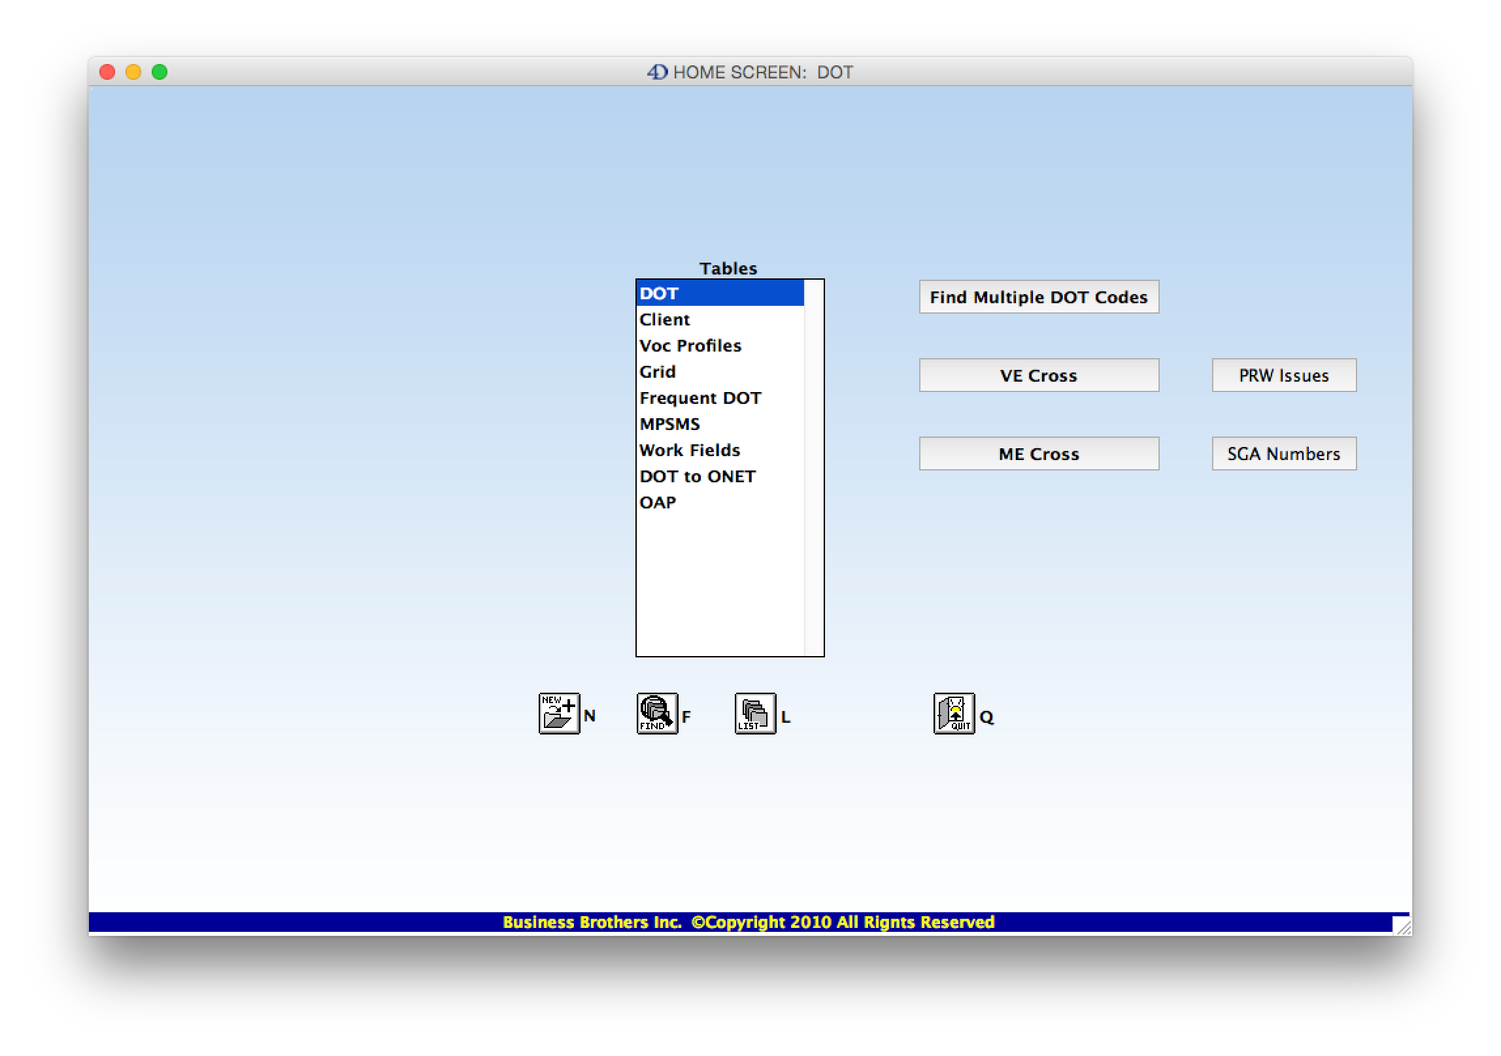
This is the Home Screen of RepToolsSSD. The button that is circled contains information about Past Relevant Work
Issues. If we click on this button we get…

Slide 3
…this. There are so many details involved in determining what Past Relevant work is, that you can’t do a good job
of analyzing it unless you have a good checklist to work from. The purpose of this is to prepare arguments that will
eliminate as many past jobs from being past relevant work so that we can get over step 4.

Slide 4
Here is a continuation of the checklist on how to eliminate past work as past relevant work.

Slide 5
And here is the last page of the checklist on how to eliminate past work as past relevant work.

Slide 6
Here we are back at the home page. The SGA Numbers button contains the following information…

Slide 7
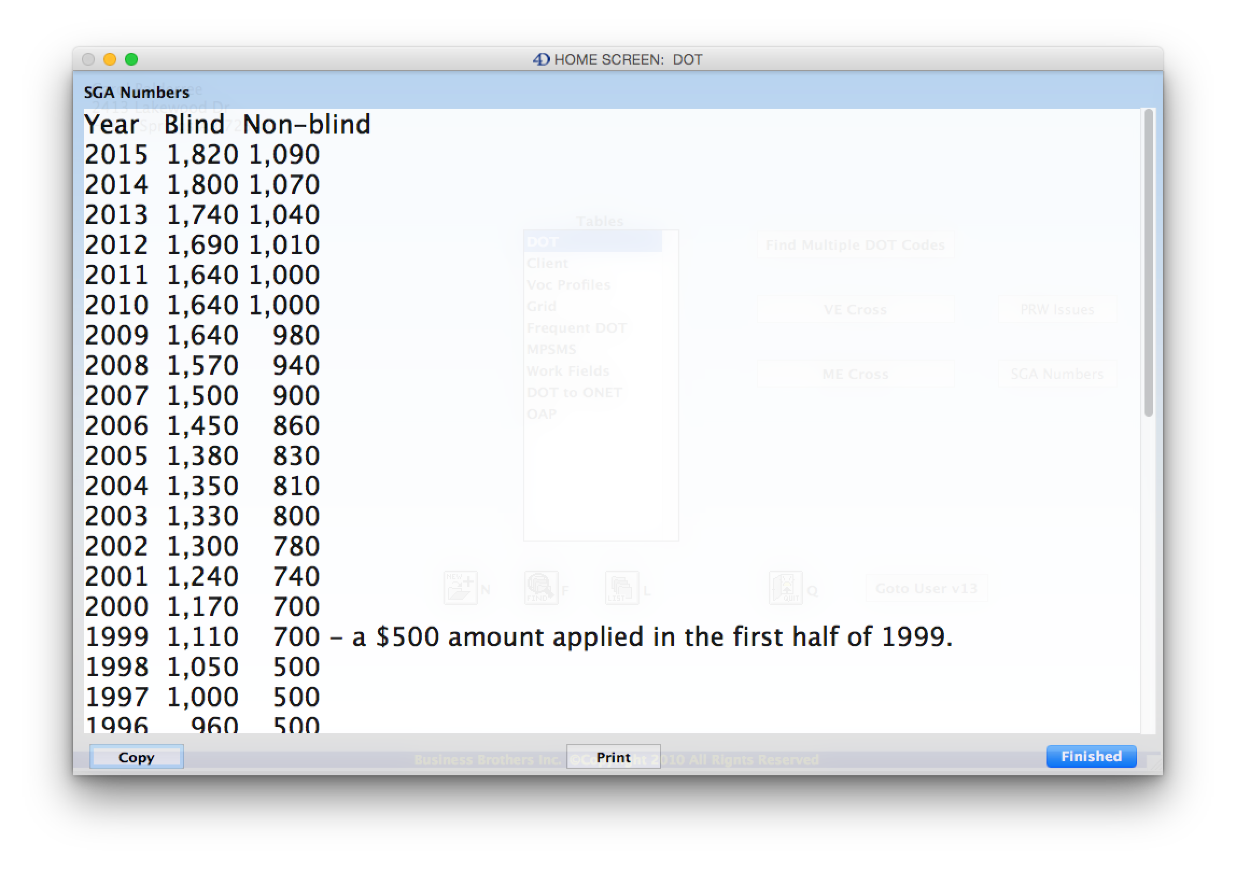
If work was not done at the SGA level, it is not past relevant work. This table of SGA numbers is helpful when looking
back at how much a person earned and whether the work may fail this test for past relevant work.

Slide 8
Back at the home screen again we have another button named VE Cross. This button contains information on various
Vocational Expert Cross Examinations that you may need to use at a hearing.

Slide 9
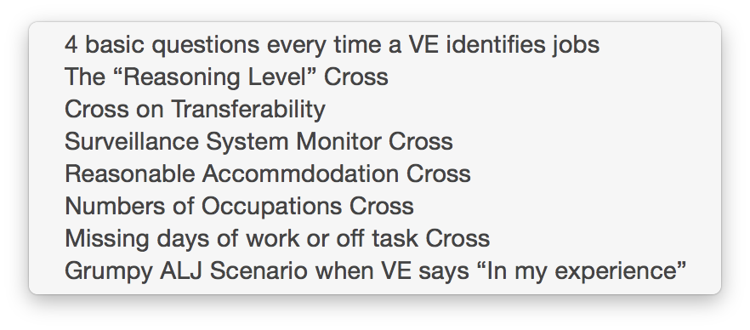
Here is the list of various Vocational Expert Cross Examinations. These are not my inventions. I have collected
these from various sources, mostly from NADR members. The source of each examination is given at the end
of each cross examination. The cross examinations are:

Slide 10
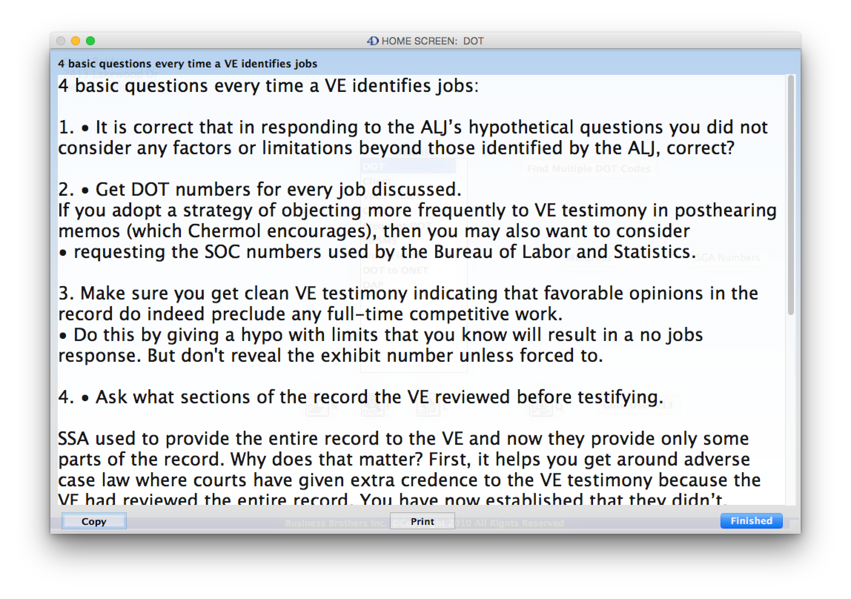
Here are the 4 basic questions you should ask every time a VE identifies jobs. This is from Dave Chermol. Notice that
the words you can use in the cross examination are preceded with a bullet (•). This should help to bring your eyes
directly to the words for the cross examination. The font size is large so that you can read it at a hearing.

Slide 11
Next we have some Medical Expert Cross Examinations…

Slide 12
Here is the list of the Medical Expert cross examinations that are currently included in RepToolsSSD. Let’s take a look at the
second one, the “Average Person” Cross…

Slide 13
The idea here is to get the Medical Expert to admit that his/her testimony is based on the “average” person and the
objective medical evidence alone without taking into account the complaints of the individual.

Slide 14
Here we are back at the home screen and we are going to look at the “Find Multiple DOT Codes” interface…

Slide 15
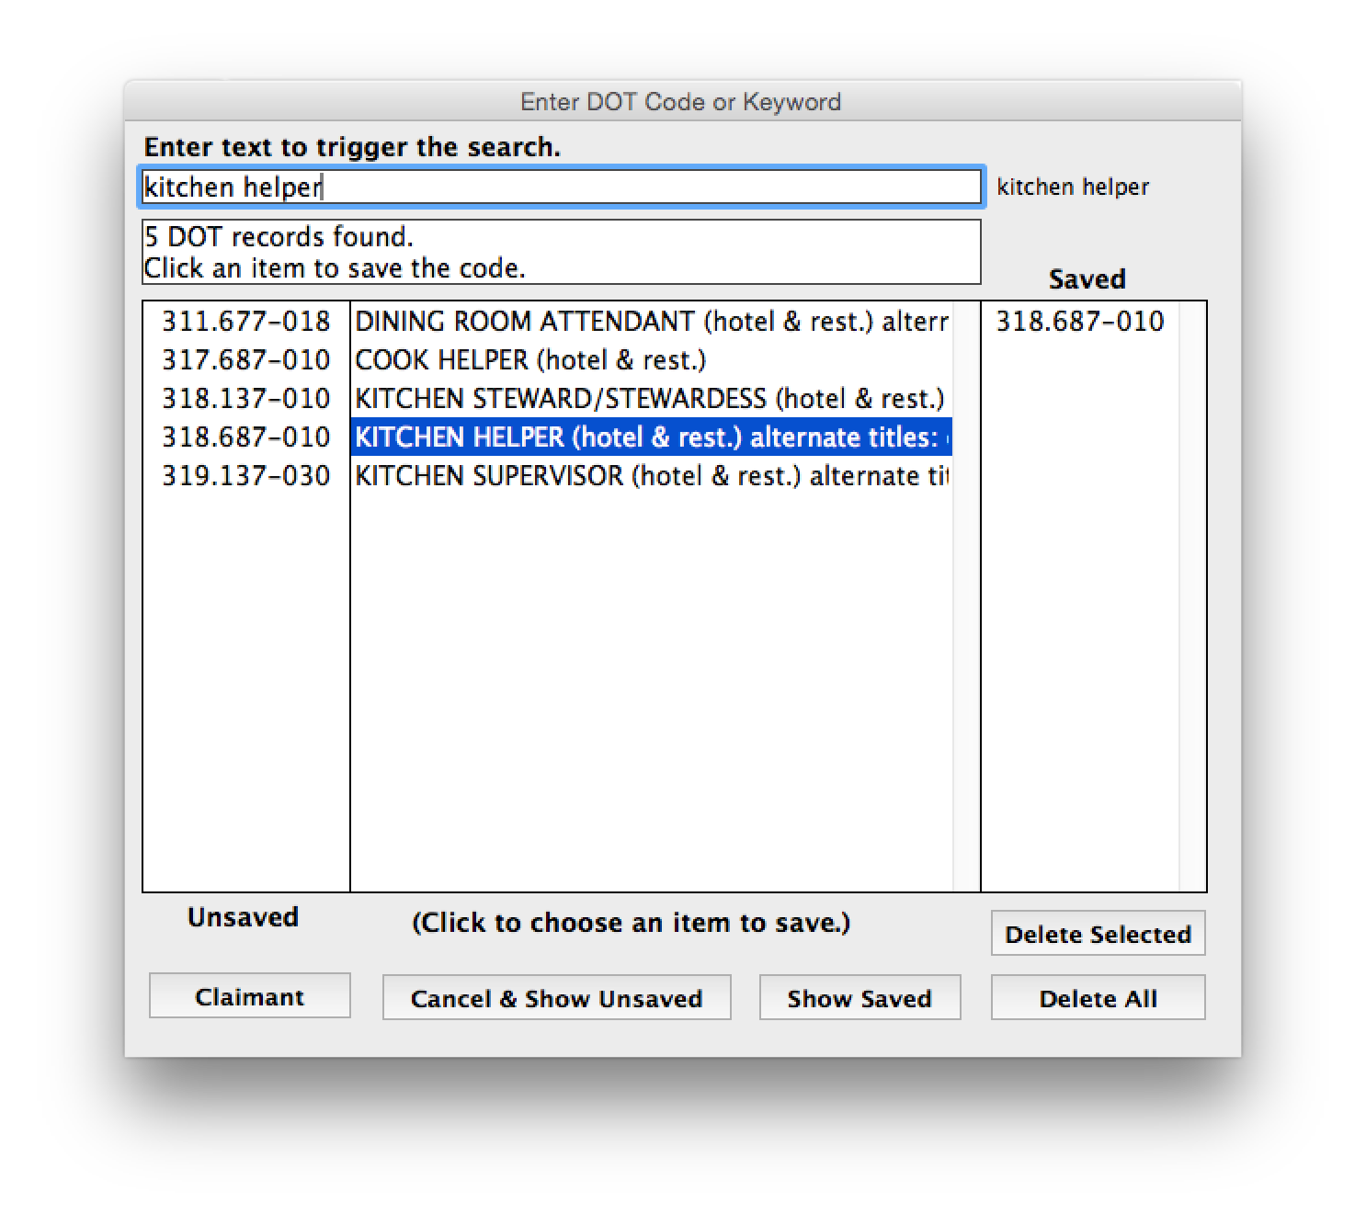
As you enter text that you think might be included in the DOT Title or description, the list of DOT Codes is narrowed
down. Any text that you click on will cause the DOT Code to appear in the “Saved” column on the right. There are
buttons in the footer, such as the “Show Saved” that if clicked will show you the list of everything in the “Saved” column.

Slide 16
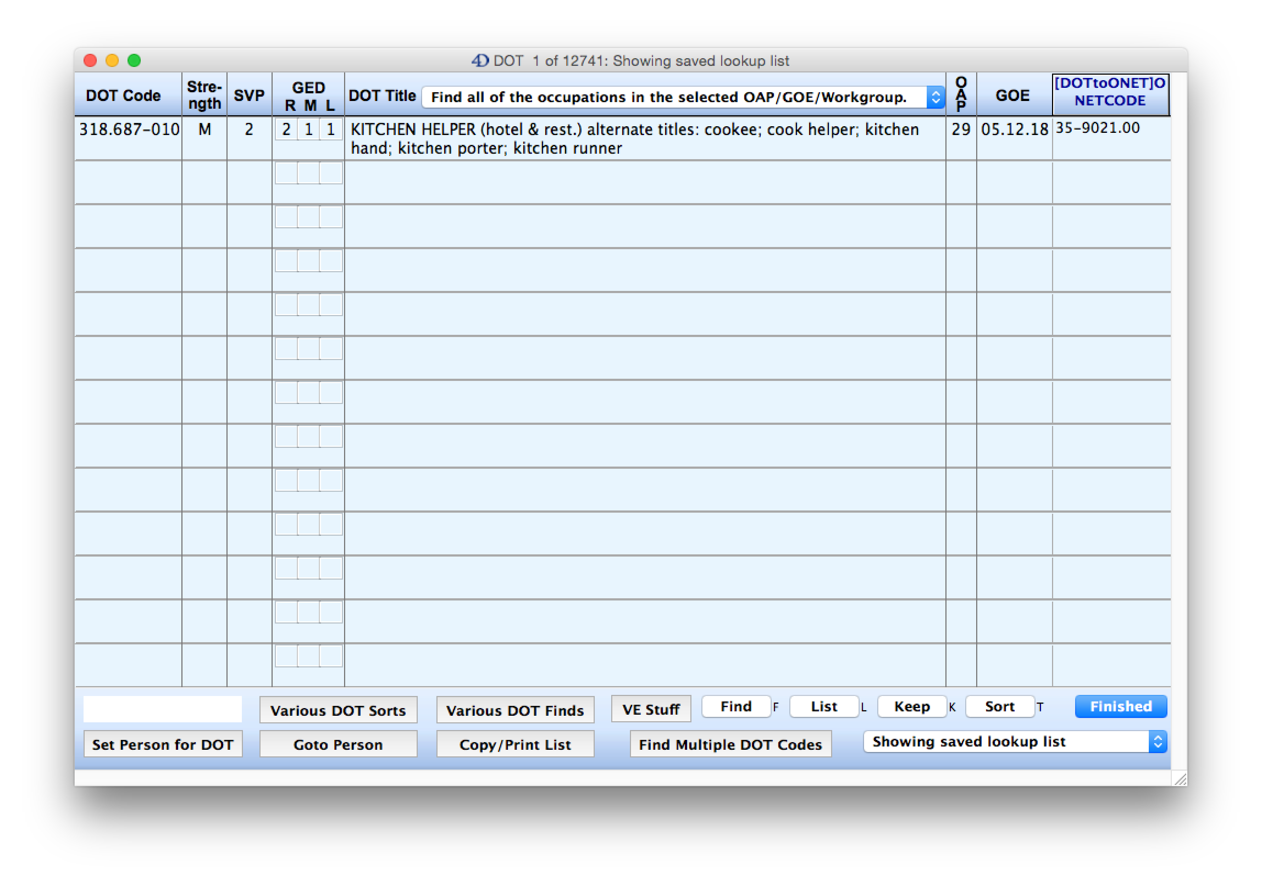
So this is what we get when you click the “Show Saved” button on the previous page.

Slide 17
Back at the home screen we are looking at the list of tables in RepToolsSSD. This DOT table is where you
will do almost all of your work. If you double click the DOT table, you will get…

Slide 18
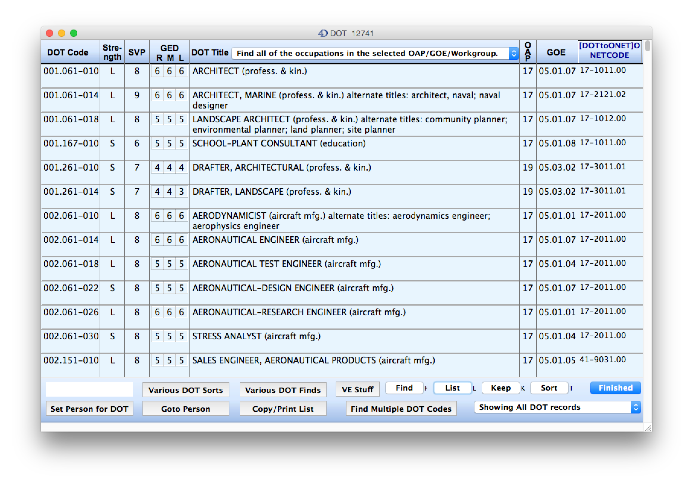
…this which is showing all 12,741 DOT records. I have circled the “VE Stuff” button which we will look at next…

Slide 19
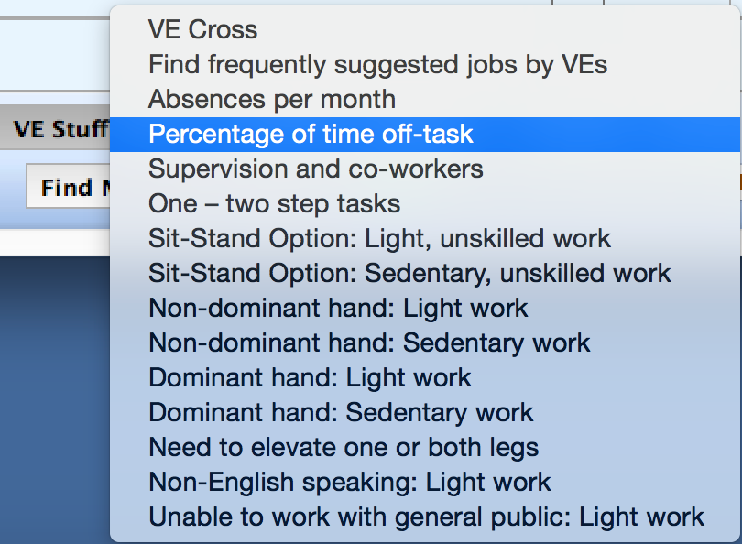
Here are the choices you get in the “VE Stuff” button. Let’s look at a couple of these items.
First, the “Percentage of time off-task item…

Slide 20
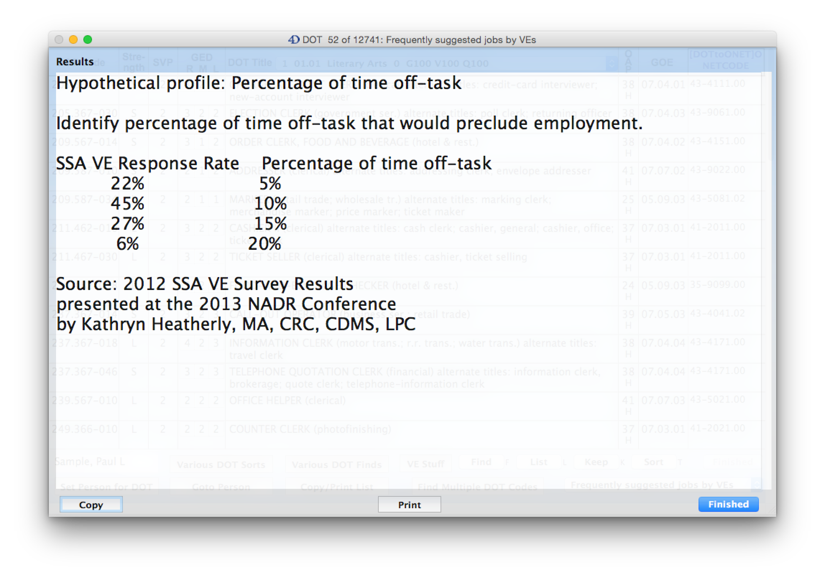
All of this information came from a presentation by Kathryn Heatherly at the 2013 NADR Conference. Something like
233 Vocational Experts were surveyed. In this hypothetical profile they were asked to give the percentage of time off-task
that would preclude employment. Fifteen percent of time off-task seems to be supported by 94% of the VEs as precluding
employment. That is a good thing to know so that you can give an effective hypothetical yourself.

Slide 21
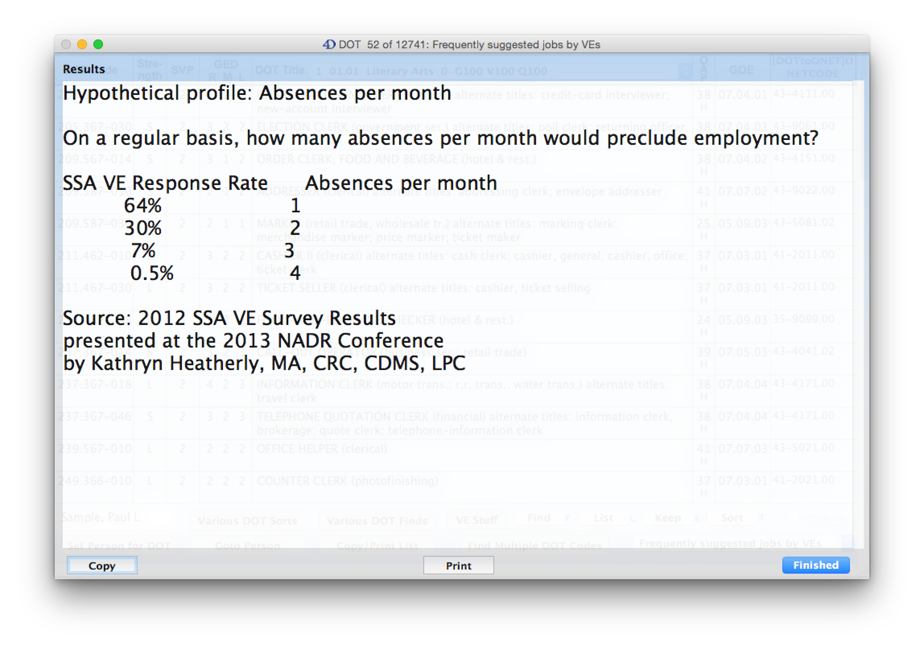
Here is a hypothetical profile on absences per month. It appears that better than 90% of VEs would say that 2 absences
per month on a regular basis would preclude employment. This can help you to develop an effective hypothetical.
This information is also helpful in developing your theory of the case and in deciding whether you should take on a case.

Slide 22
Here we are back at the list view in the DOT table. The “Various DOT Finds” button is circled. This brings us to…

Slide 23
…this list of items. So we will choose the first item, “Find SCO Attributes” which means “Selected Characteristics
of Occupations.”

Slide 24
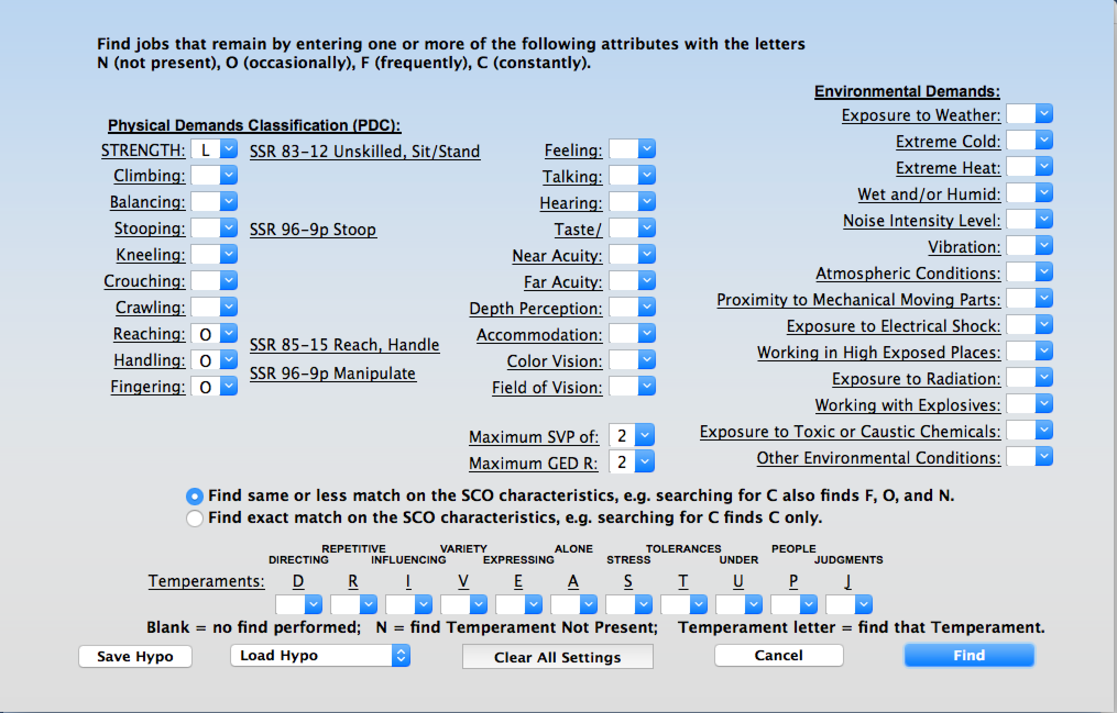
…which brings us to this interface. Maybe you are trying to set these items to match what DDS found, or what an
ALJ had in a certain hypothetical. You are checking to see if DDS or the VE got things right and if not, you are going to
argue that they were wrong. It is not always easy to duplicate an ALJ hypothetical when they throw around terms like
“simple, repetitive, one or two step jobs”. When you have everything set, click the “Find” button…

Slide 25
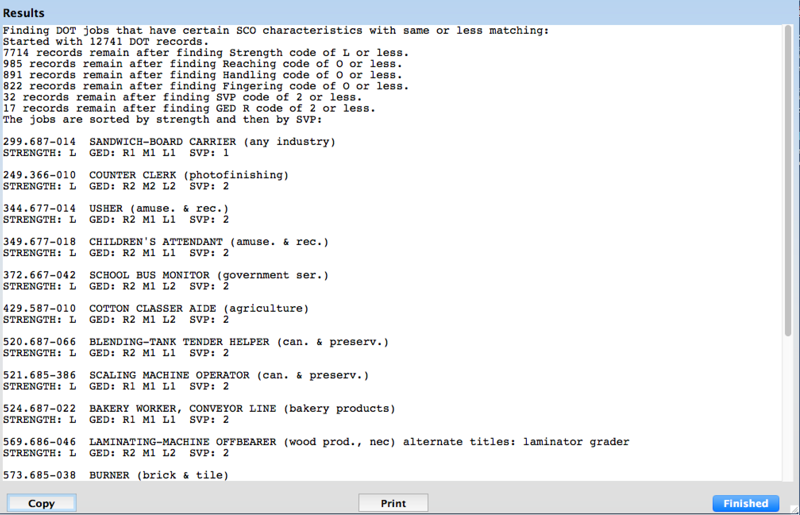
…which brings us to this report. Notice that RepToolsSSD does all of the searches that you set it up to do on the previous
page. Then it tells you how many jobs are left after performing each search. Finally it lists the jobs. The entire methodology is
reproduced in words. You are able to find out if DDS or the Vocational Expert did their job correctly.

Slide 26
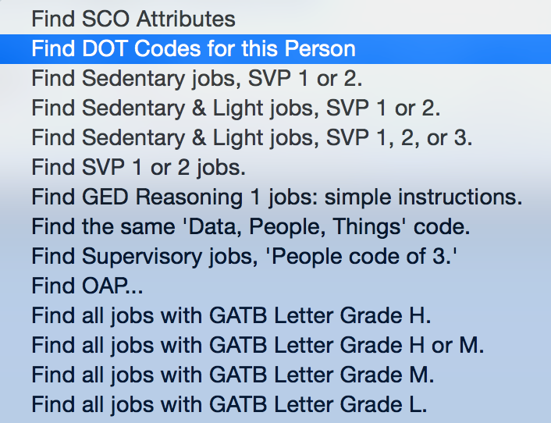
The next item in the VE Stuff” button is “Find DOT Codes for this Person.

Slide 27
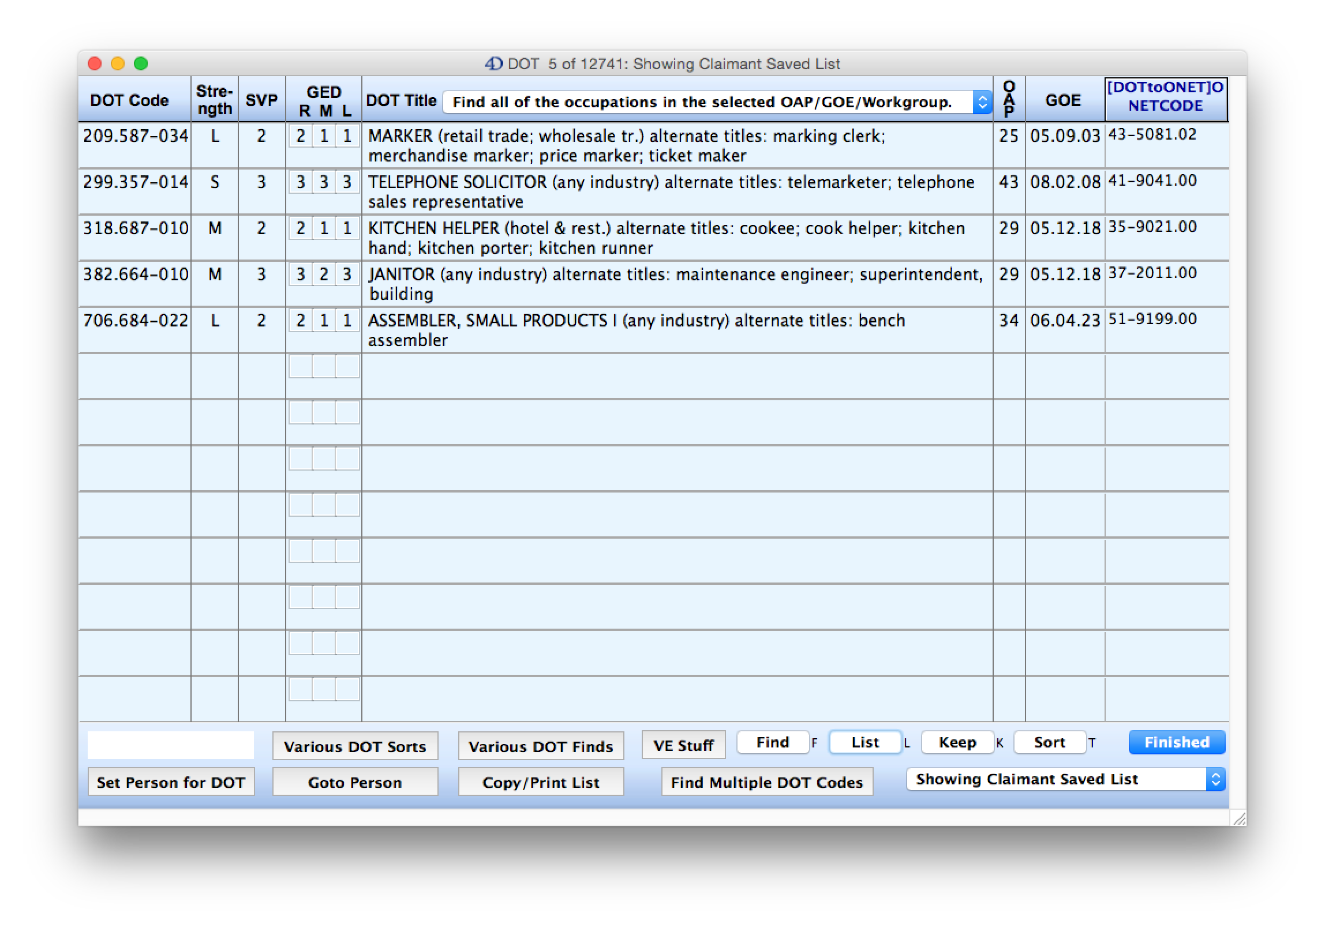
We get the occupations that were saved for this person. In this case we have a blank person which some people prefer.
Any time you are in the DOT List View as shown above, you can click on the blank white box or the person’s name in
that box and you will get the list of saved DOTs for that person. If we double click on the MARKER occupation we get…

Slide 28
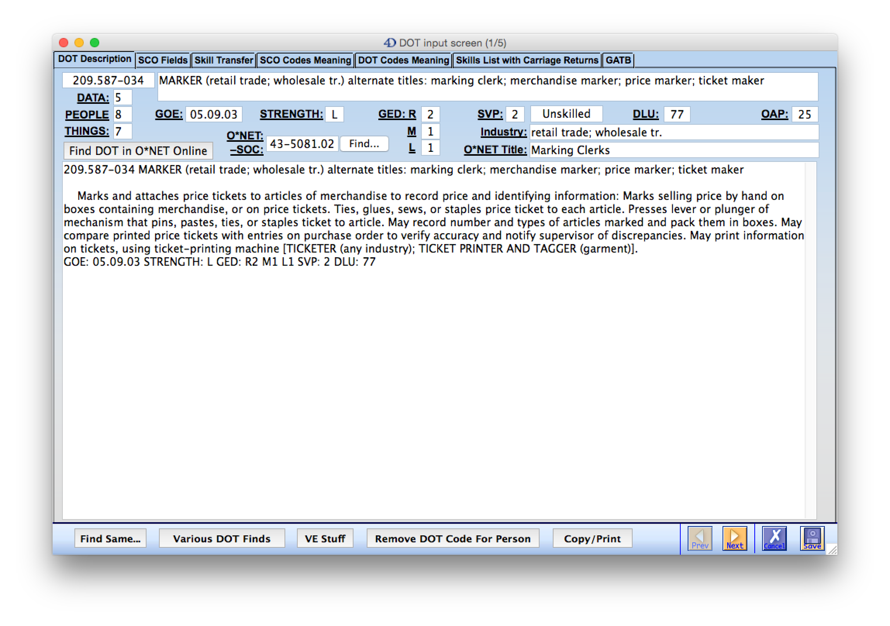
…the single record view. Notice the “Remove DOT Code for Person” button. If you click that you will get…

Slide 29
…the “Add DOT Code for Person” button. This button toggles back and forth from Add to Remove. It is as simple as
that to add or remove a DOT code for this person. Notice above that the PEOPLE code is circled. That word is
underlined. Just about any text that is underlined anywhere in RepToolsSSD has the definition for that item. Just click it…

Slide 30
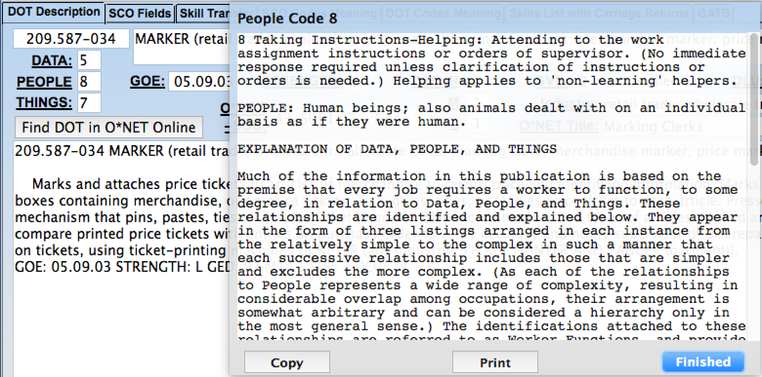
…and we get the definition for People Code 8 as shown above.

Slide 31
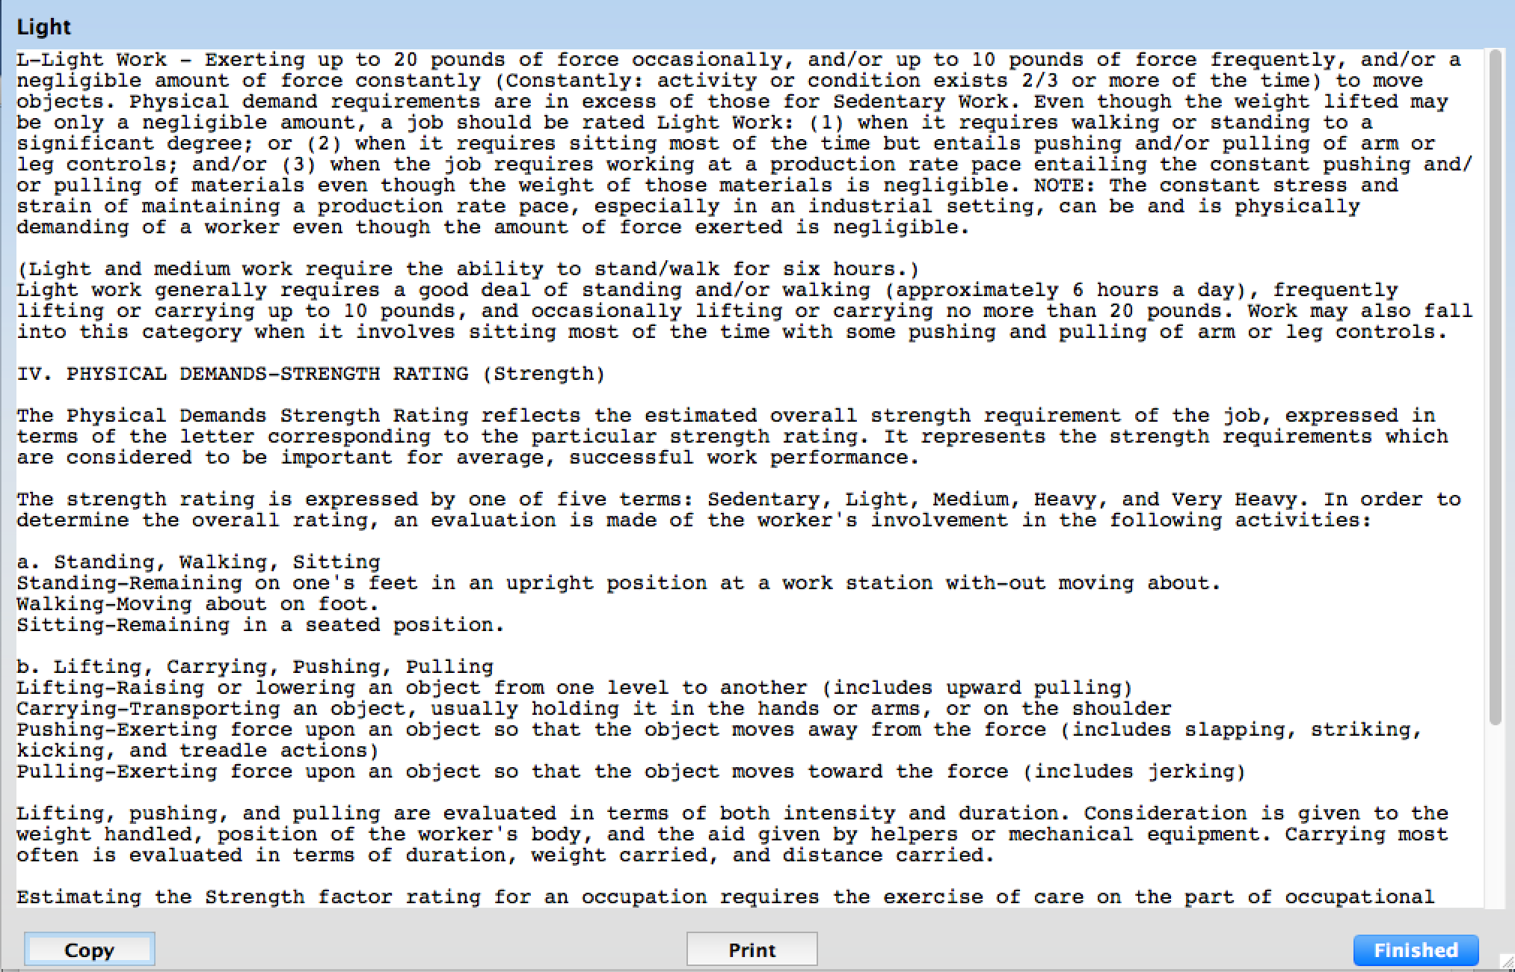
If you click on Strength L you will get what is shown on this slide. So if you are ever in doubt about what something
means, most of the time RepToolsSSD can give you the answer.

Slide 32
On the “DOT Description” tab, there is a button named “Find DOT in O*NET Online.” If you click that
you will get…

Slide 33
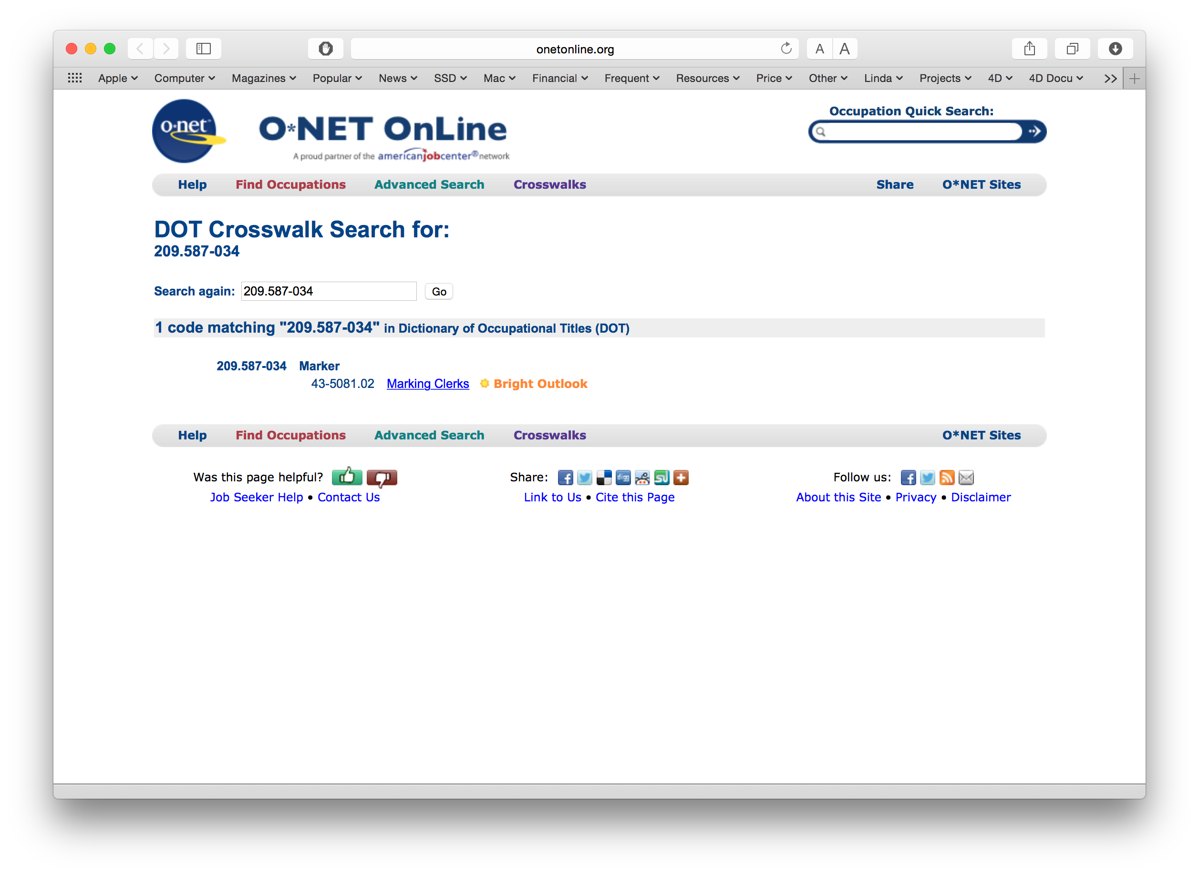
…this. This is one source for numbers of jobs. I don’t do numbers of jobs directly in RepToolsSSD, but you can get to one of
the places that does have this information by using this interface. You do need an active internet connection to get this to work.

Slide 34
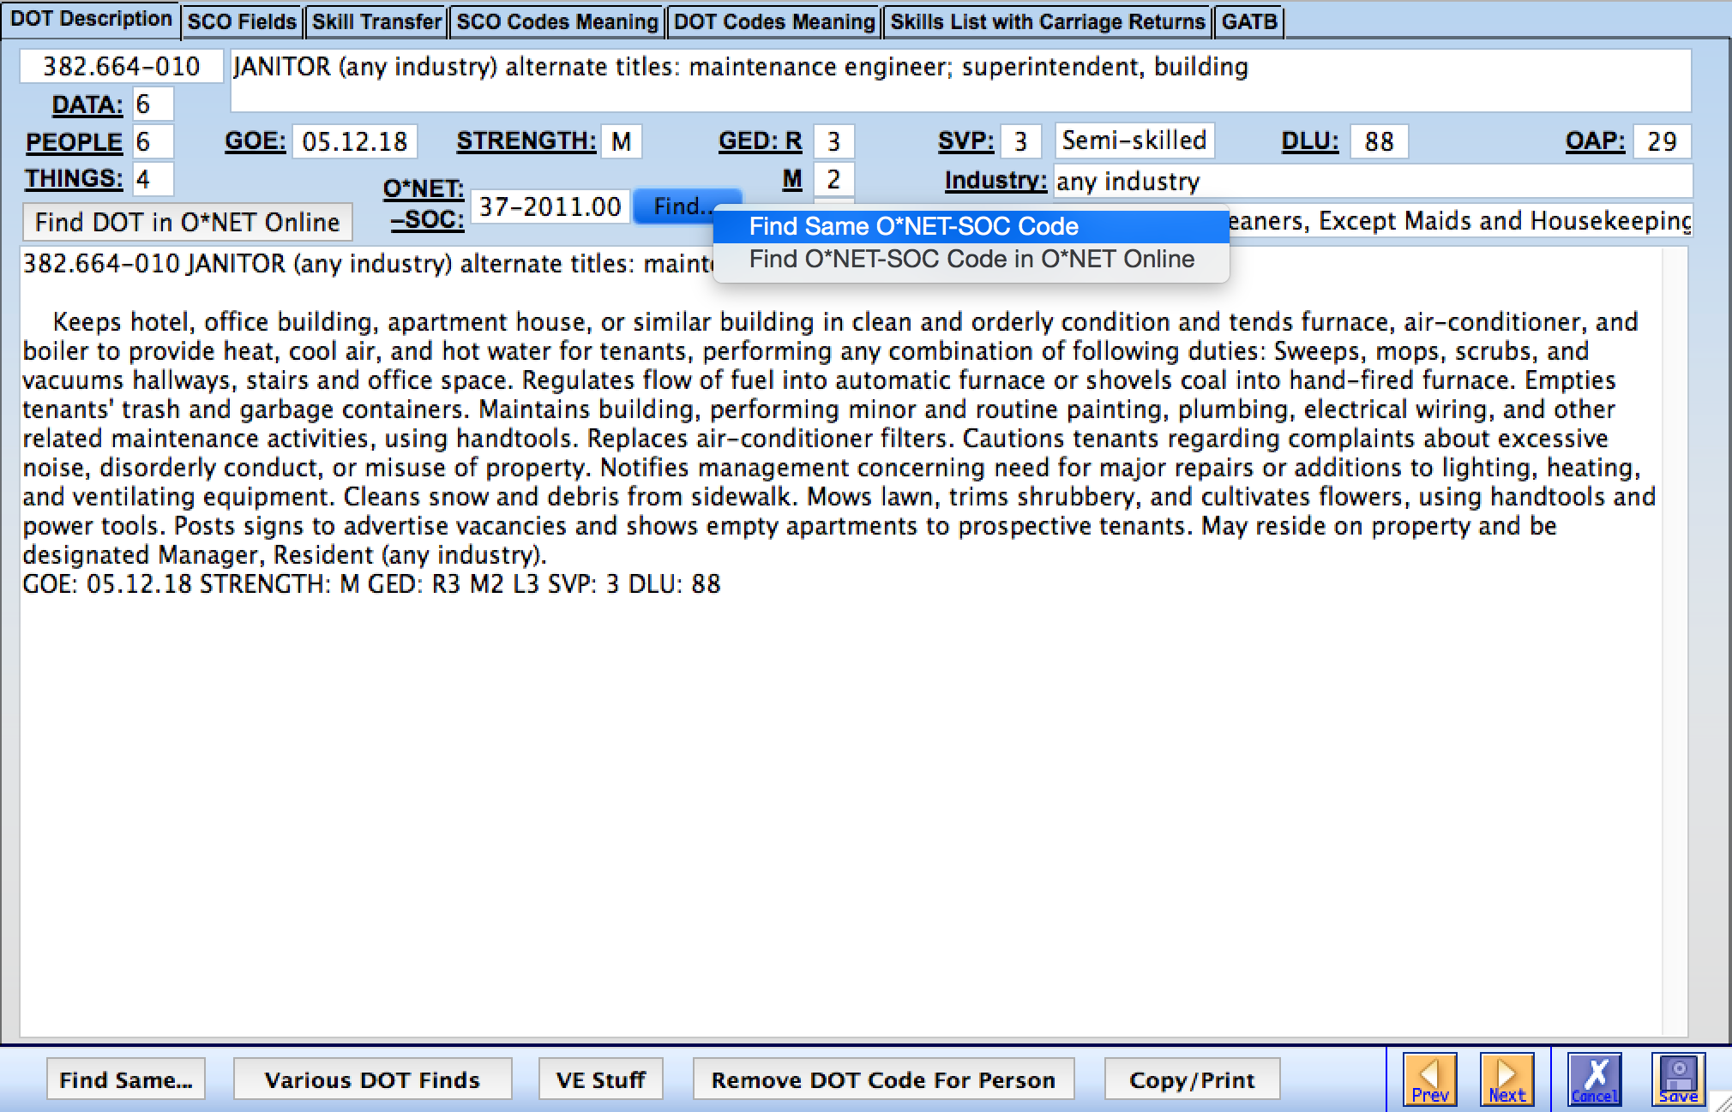
This slide shows how to find all of the other DOT records that have the same O*NET-SOC code. Numbers of jobs are published
by SOC or Census codes, not by individual DOT Codes. The DOT codes will usually have varying strength, SVP, GED-Reasoning,
etc. Look for the “Numbers of Occupations Cross” in the “VE Cross” button on the home page for further details.

Slide 35
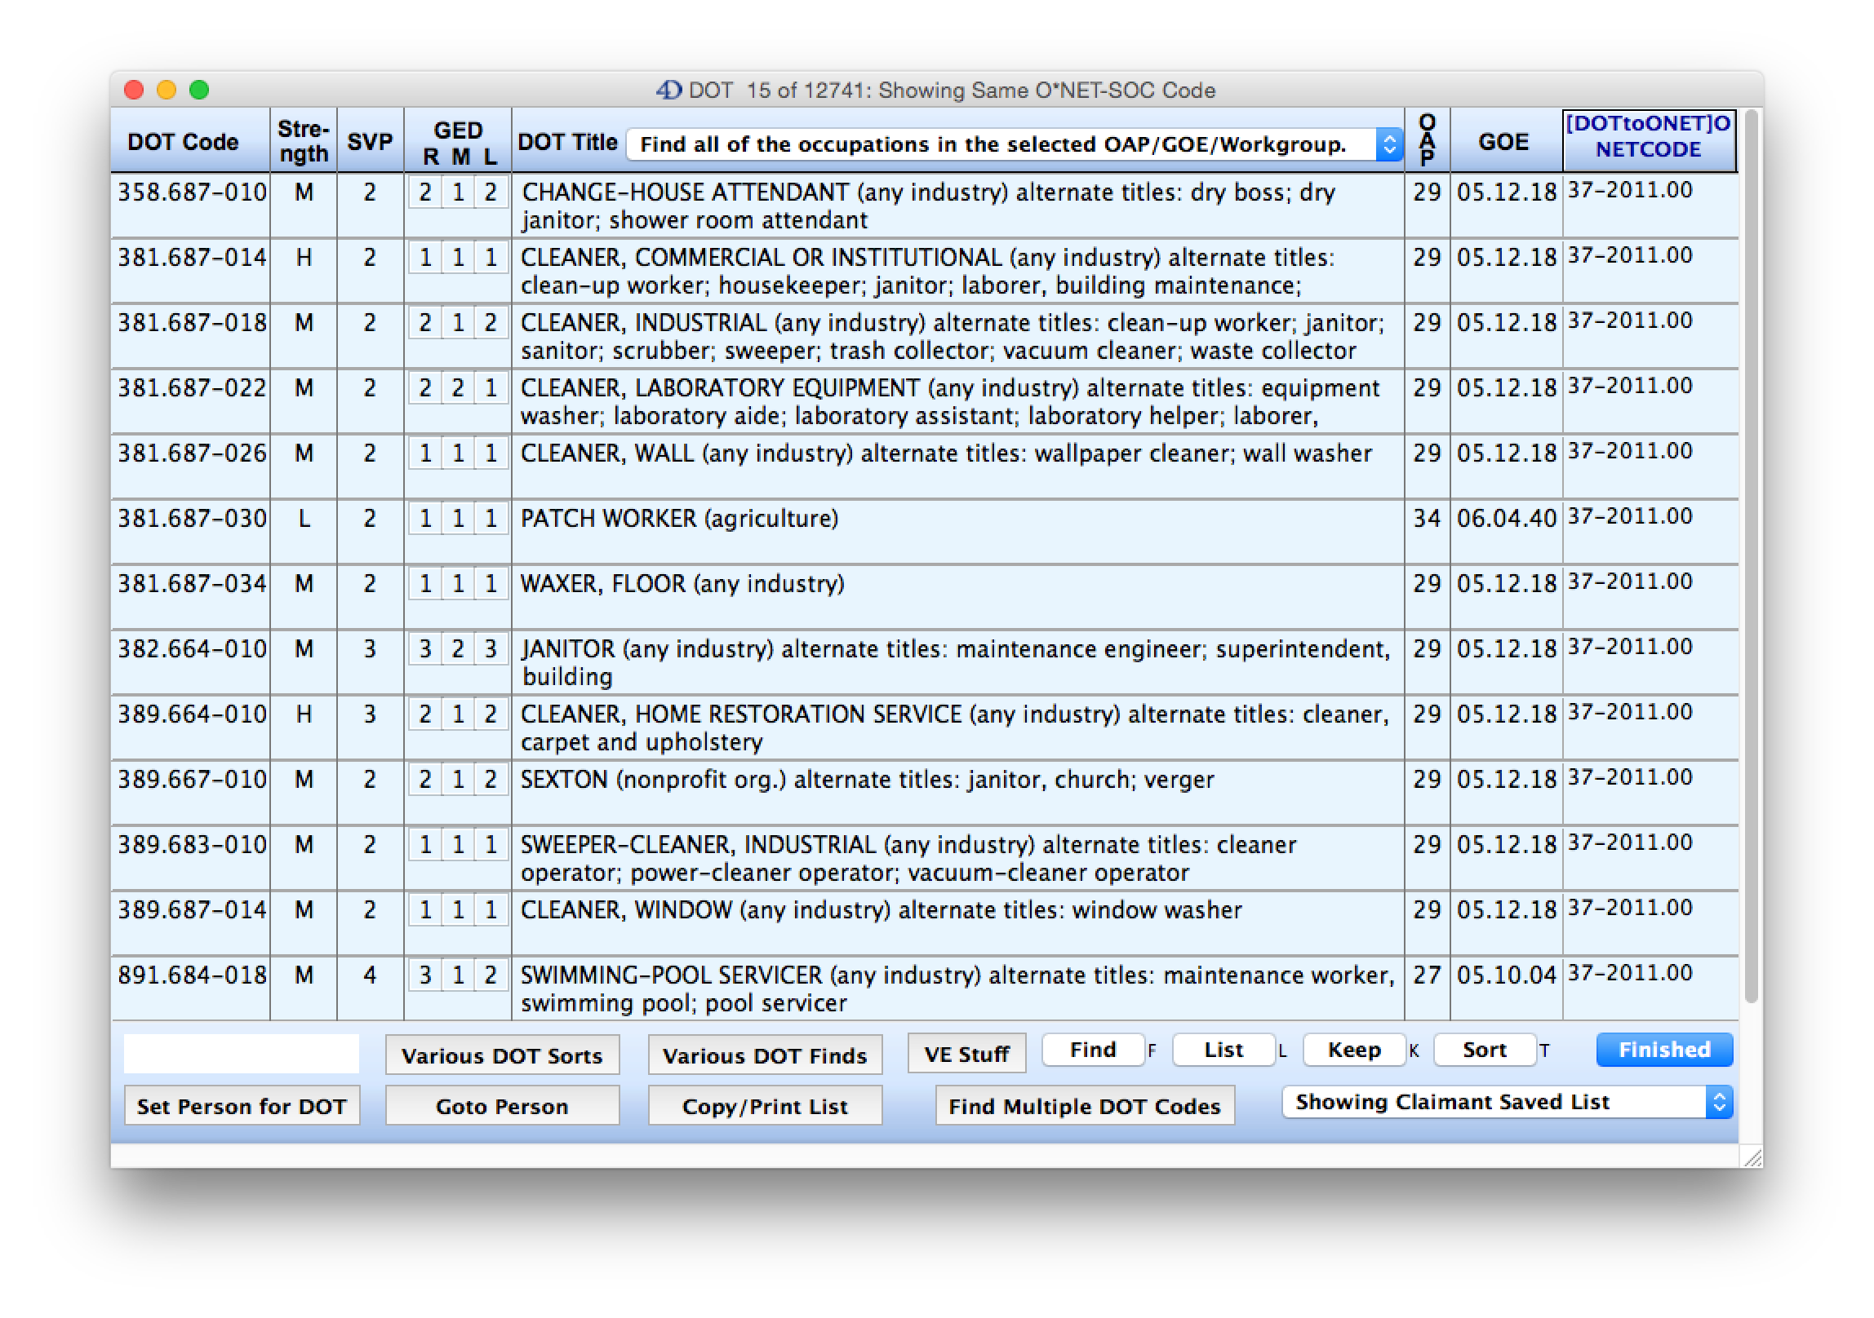
These are the resulting 15 DOT codes that have the same SOC Code for the Janitor occupation. Strength varies from
light to heavy. SVP varies from 2 to 4. GED-Reasoning varies from 1 to 3. So after you have asked the VE for the SOC codes
for each of the DOT codes that were given, then you ask whether he/she has checked all of the DOT codes for consistency
with the ALJ’s hypotheticals. Obviously NOT!

Slide 36
Here is the “Numbers of Occupations Cross” which gives complete information on how to set up and use this
cross examination.

Slide 37
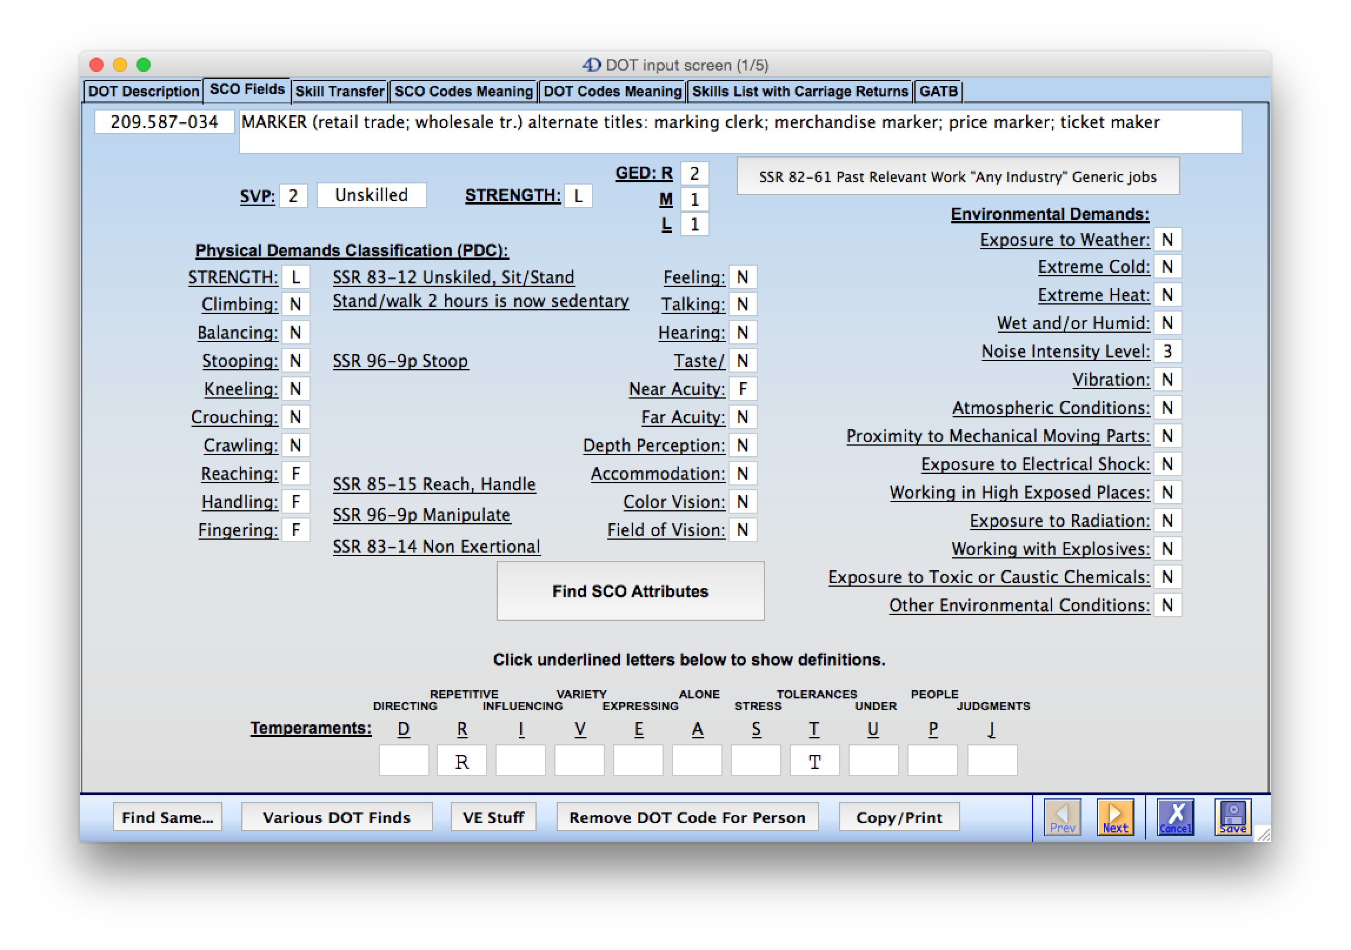
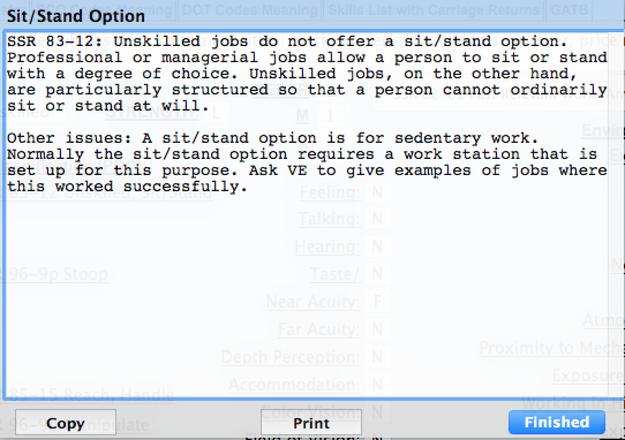
Here we are on the SCO Fields tab. Notice that next to the Strength classification, there is a reference to SSR 83-12 which
contains information pertaining to the Unskilled Sit/Stand option. If you click on the underlined reference you will get the
information on the Sit/Stand Option as shown. You can use this information to challenge VE testimony.

Slide 38
The next underlined text is entitled “Stand/Walk 2 hours is now sedentary.” David Chermol posted this to the NADR talklist
on 2/18/2015.

Slide 39
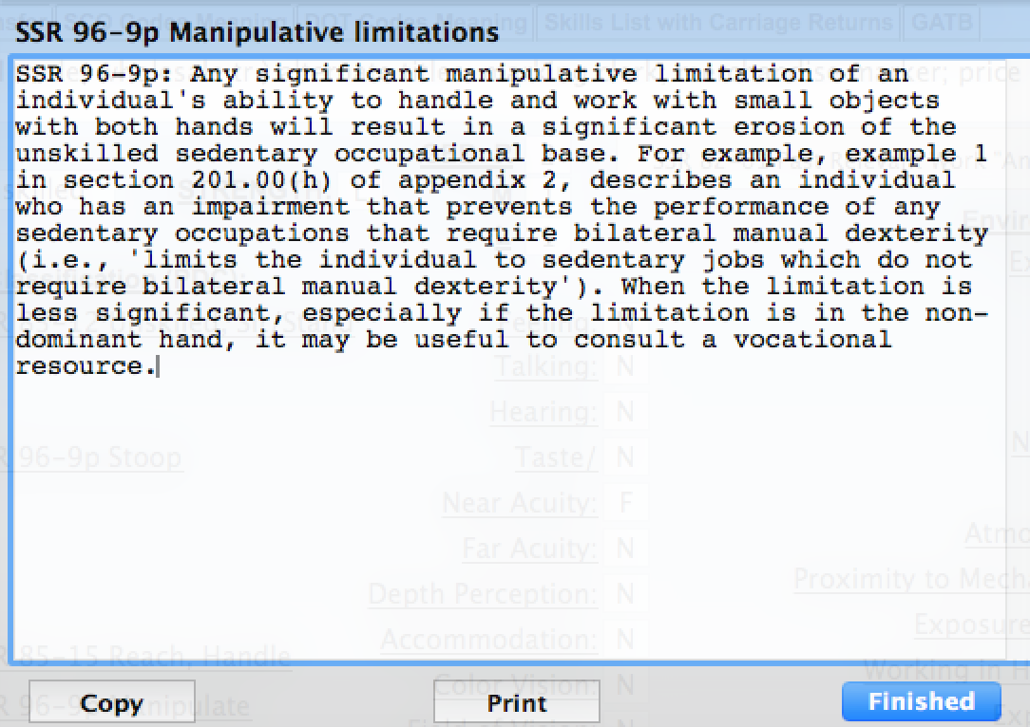
Here is the reference to SSR 96-9p regarding manipulative limitations. This reference is placed next to the Handling and
Fingering characteristics because those are the ones that they pertain to. These are things that you would want to consider
in the development of your theory of the case or perhaps put this in a hearing brief or post hearing brief.

Slide 40
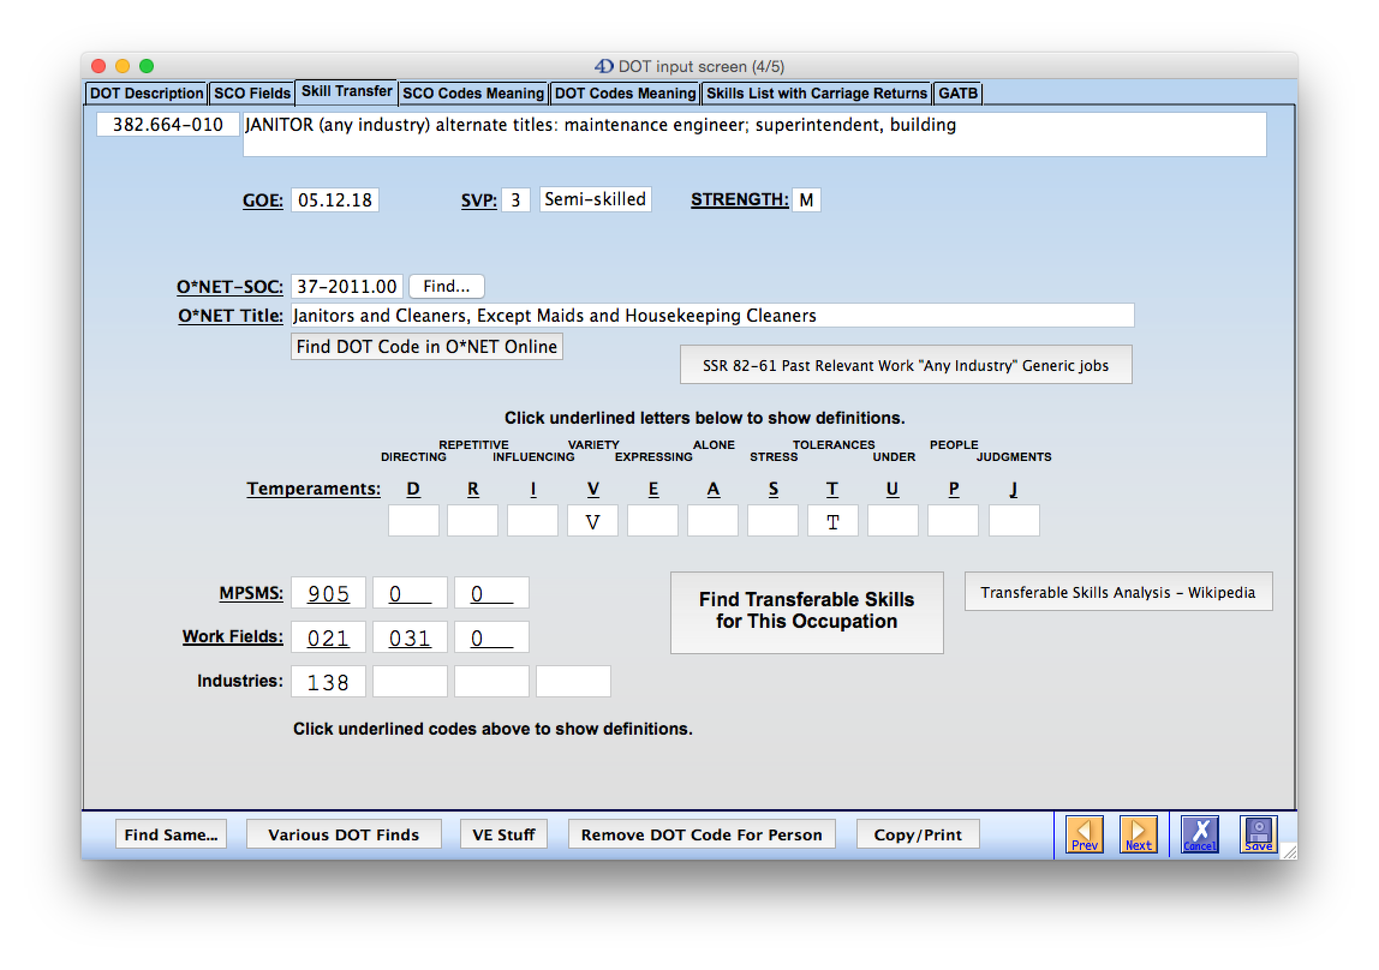
We are moving on to the “Skill Transfer” tab. Click the “Find Transferable Skills for this Occupation” button
and this is what we get…

Slide 41
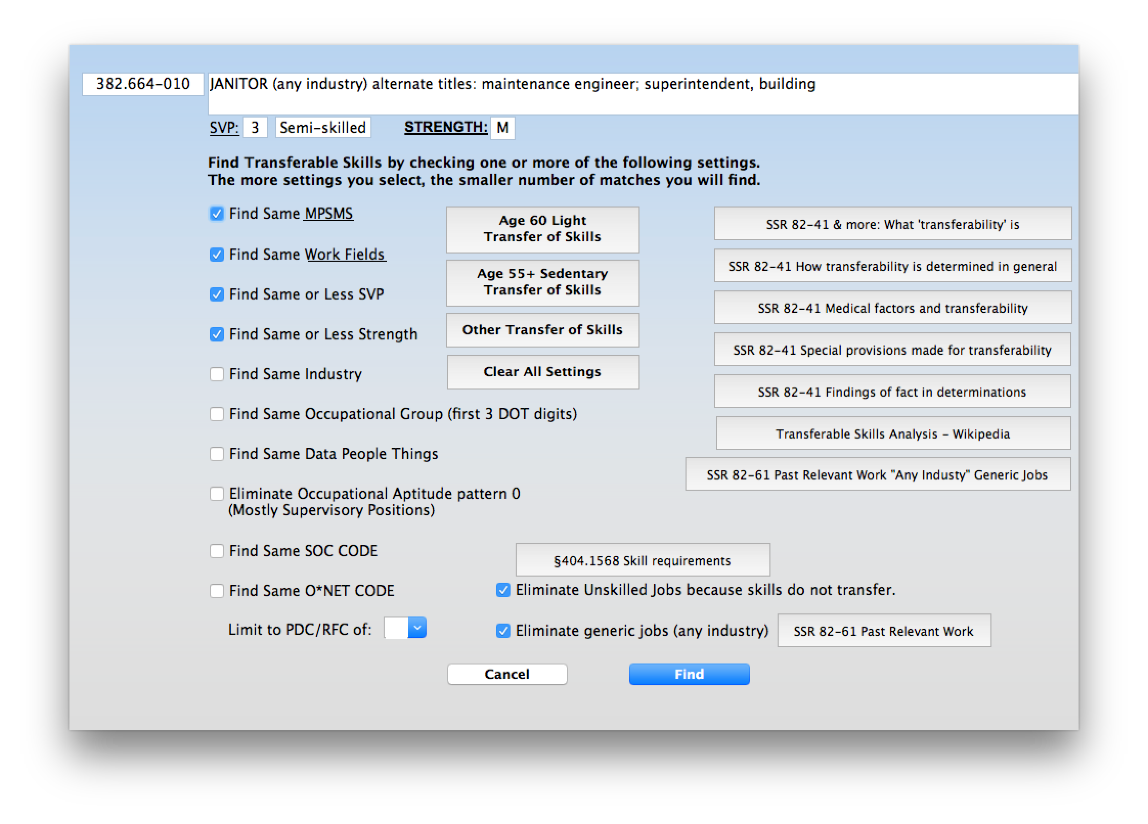
Now you will need to set how the skill transfer analysis is done. It is currently set for “Other Transfer of Skills. This would
be for a person under 55 years of age. Notice on the right column there are a number of SSR references which explain
a variety of things related to a Transfer of Skill Analysis. Now we click the Find button and this is what we get…

Slide 42
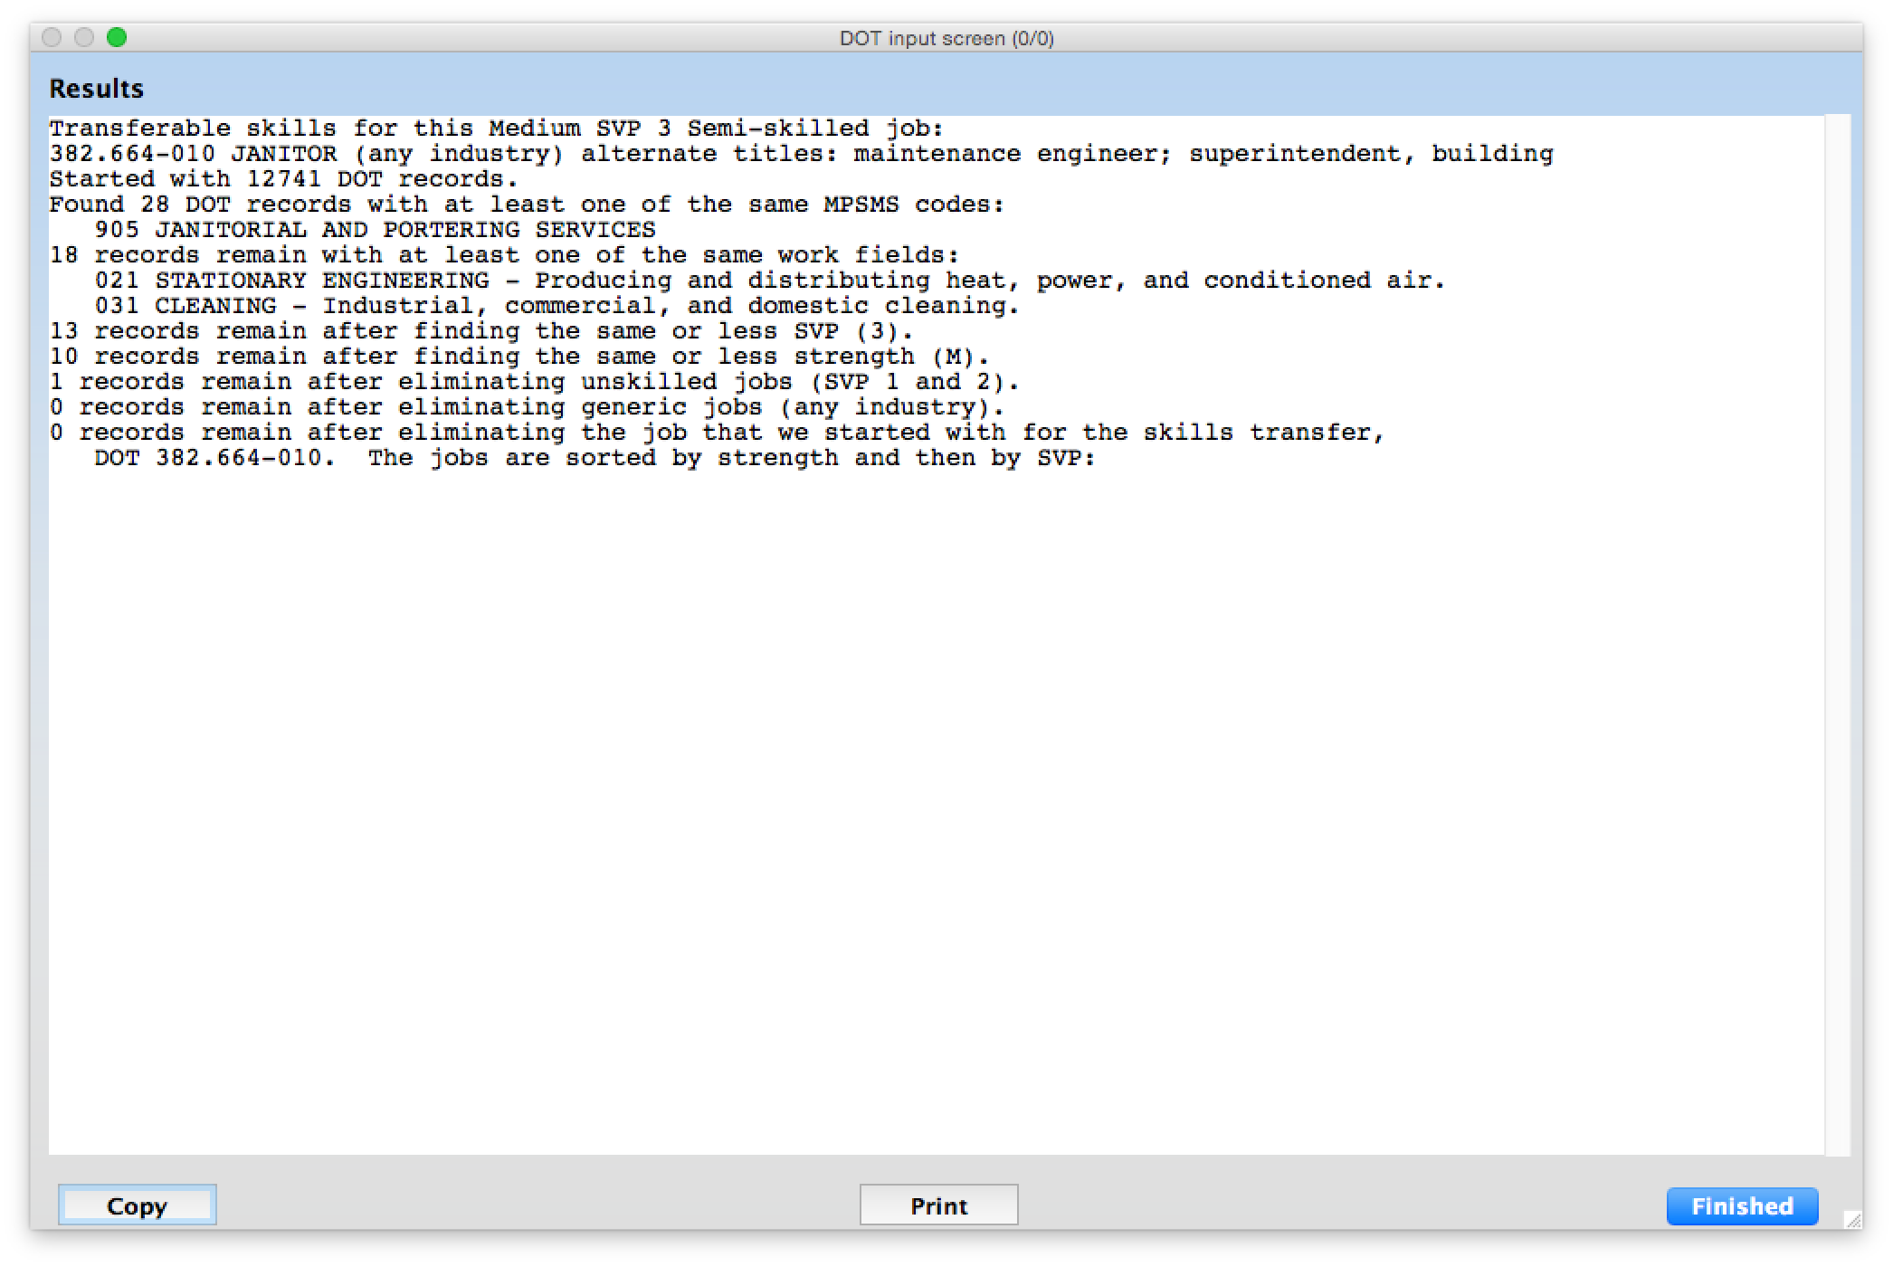
This report tells you exactly how RepToolsSSD narrowed down the occupations. It found 28 DOT records with an MPSMS
Code of 905. Then it found 18 records out of the 905 that have the same Work Field code of 18, etc. until it gets to zero
matching occupations. Now if a VE tells you that this occupation has transferable skills, you can question their methodology.

Slide 43
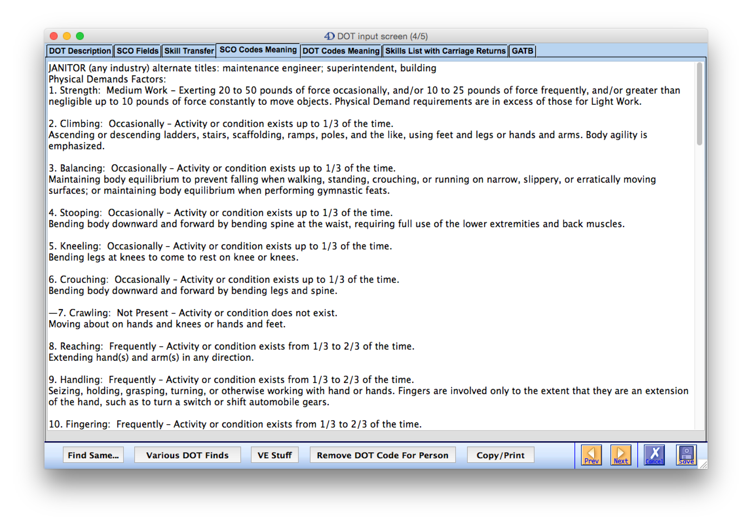
Now we move onto the “SCO Codes Meaning” tab. This gives you the definition of each of the characteristics
for this particular occupation.

Slide 44
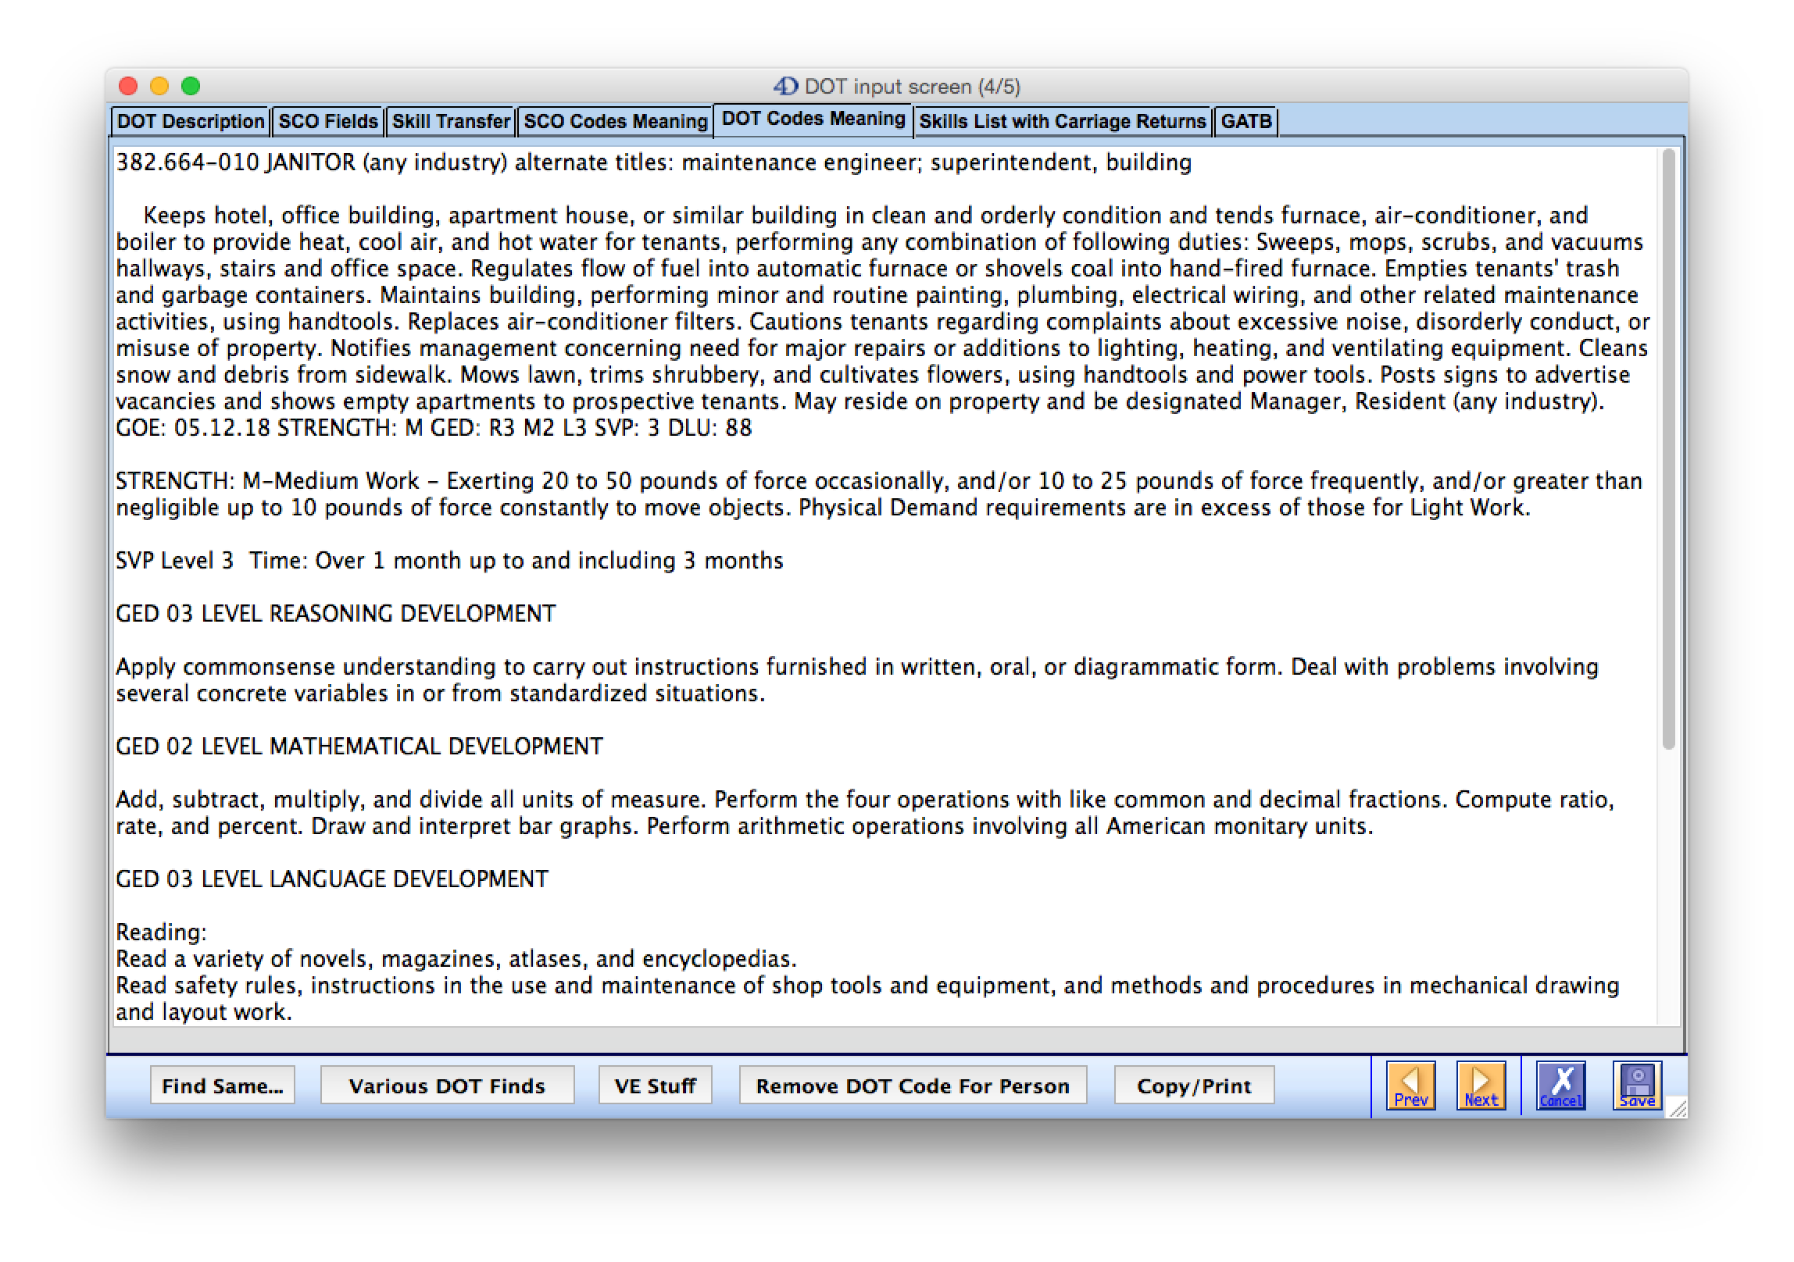
Now we move onto the “DOT Codes Meaning” tab. This gives the definitions for this occupation for Strength, GED
Reasoning, Math, and Language levels; Reading, Writing, Speaking; and the Data, People, and Things codes.

Slide 45
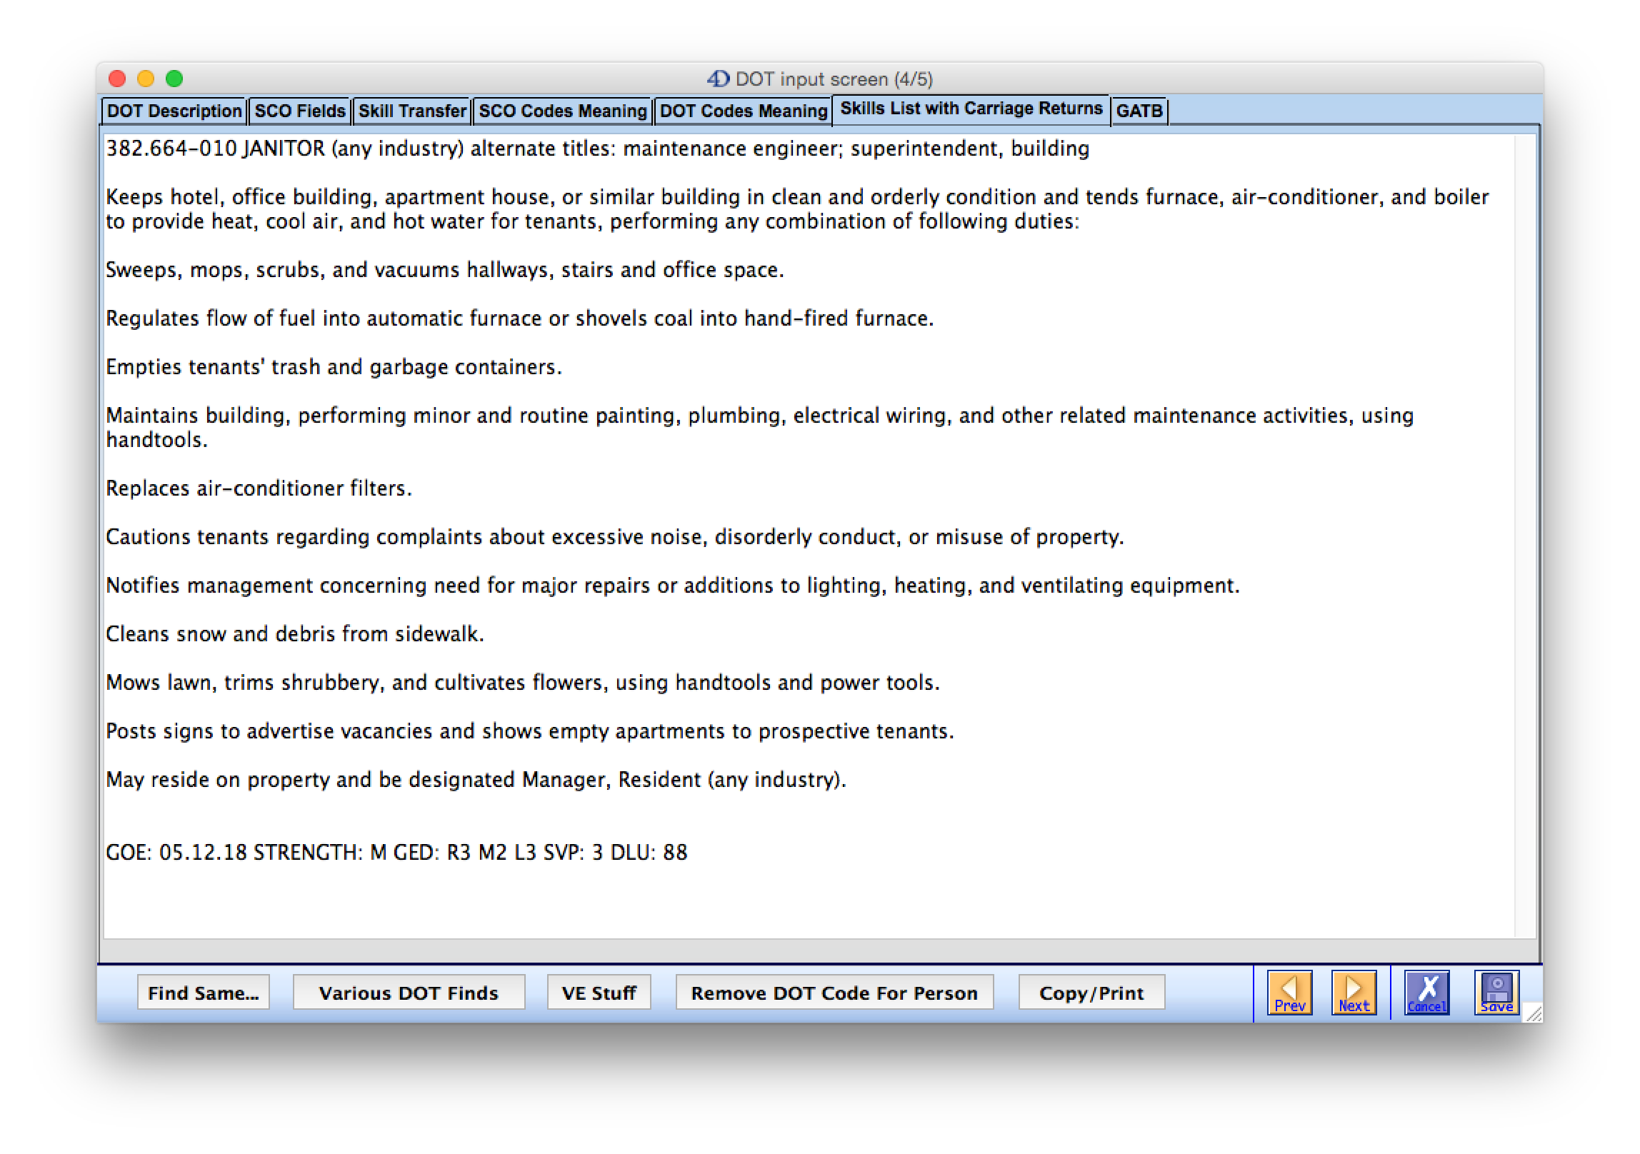
Now we move onto the “Skills List with Carriage Returns” tab. This is nothing more than a double spaced DOT Description
which is much easier to read. Identifying your client’s correct work history with the correct skill level can make a huge
difference when it comes to issues of transferability, and whether they can do past relevant work. VEs get the jobs wrong.

Slide 46
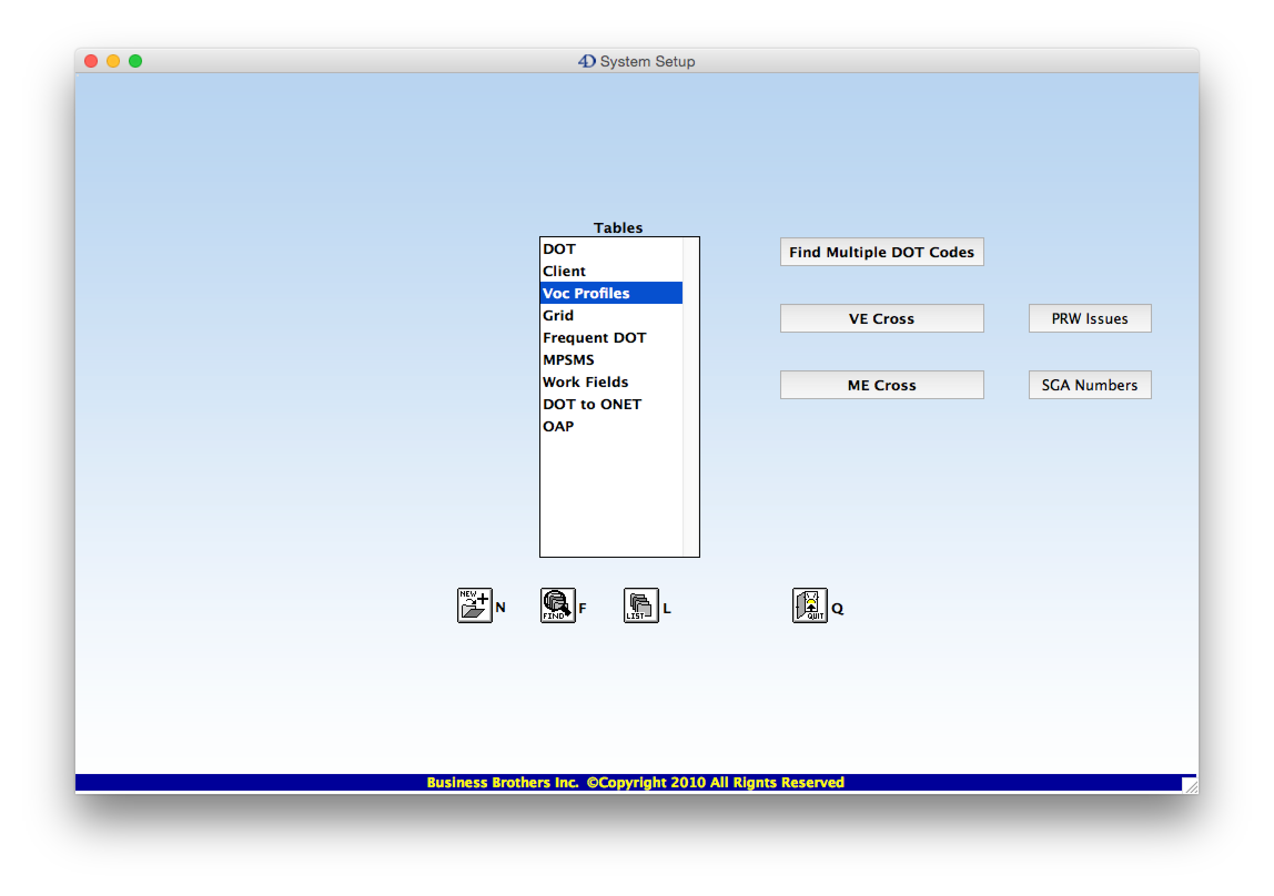
We will take a quick trip to the “Voc Profiles” table…

Slide 47
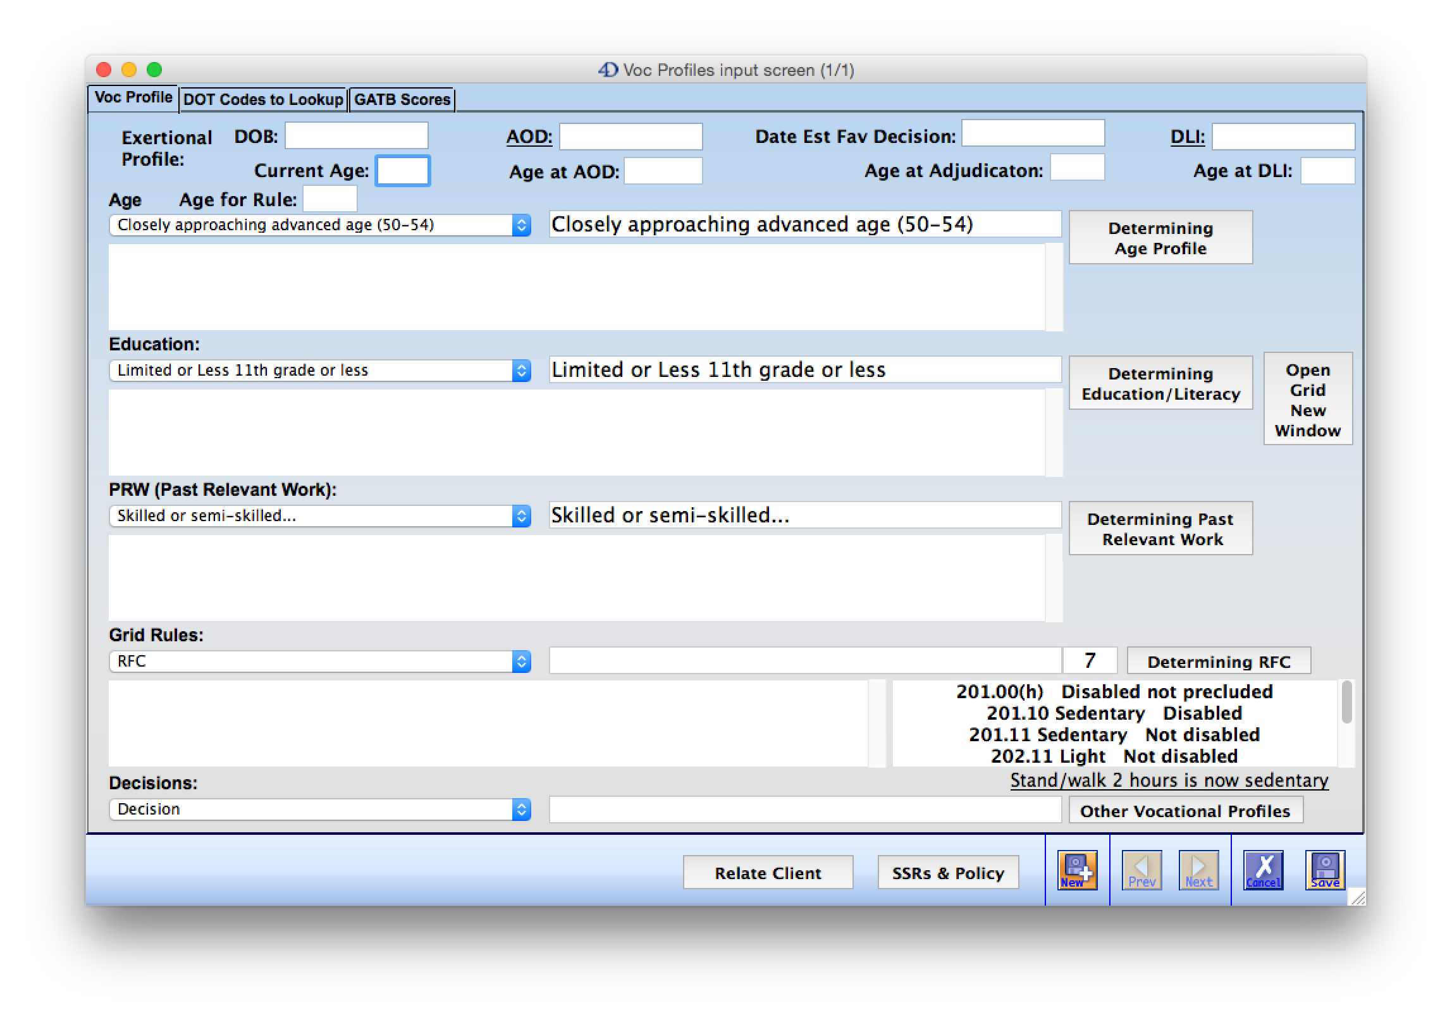
This interface helps you to set up the case for finding a grid rule that might apply. There is information on Age, Education,
and PRW that would be helpful to put into a brief. Let’s look at the “Determining Education/Literacy” Button…

Slide 48
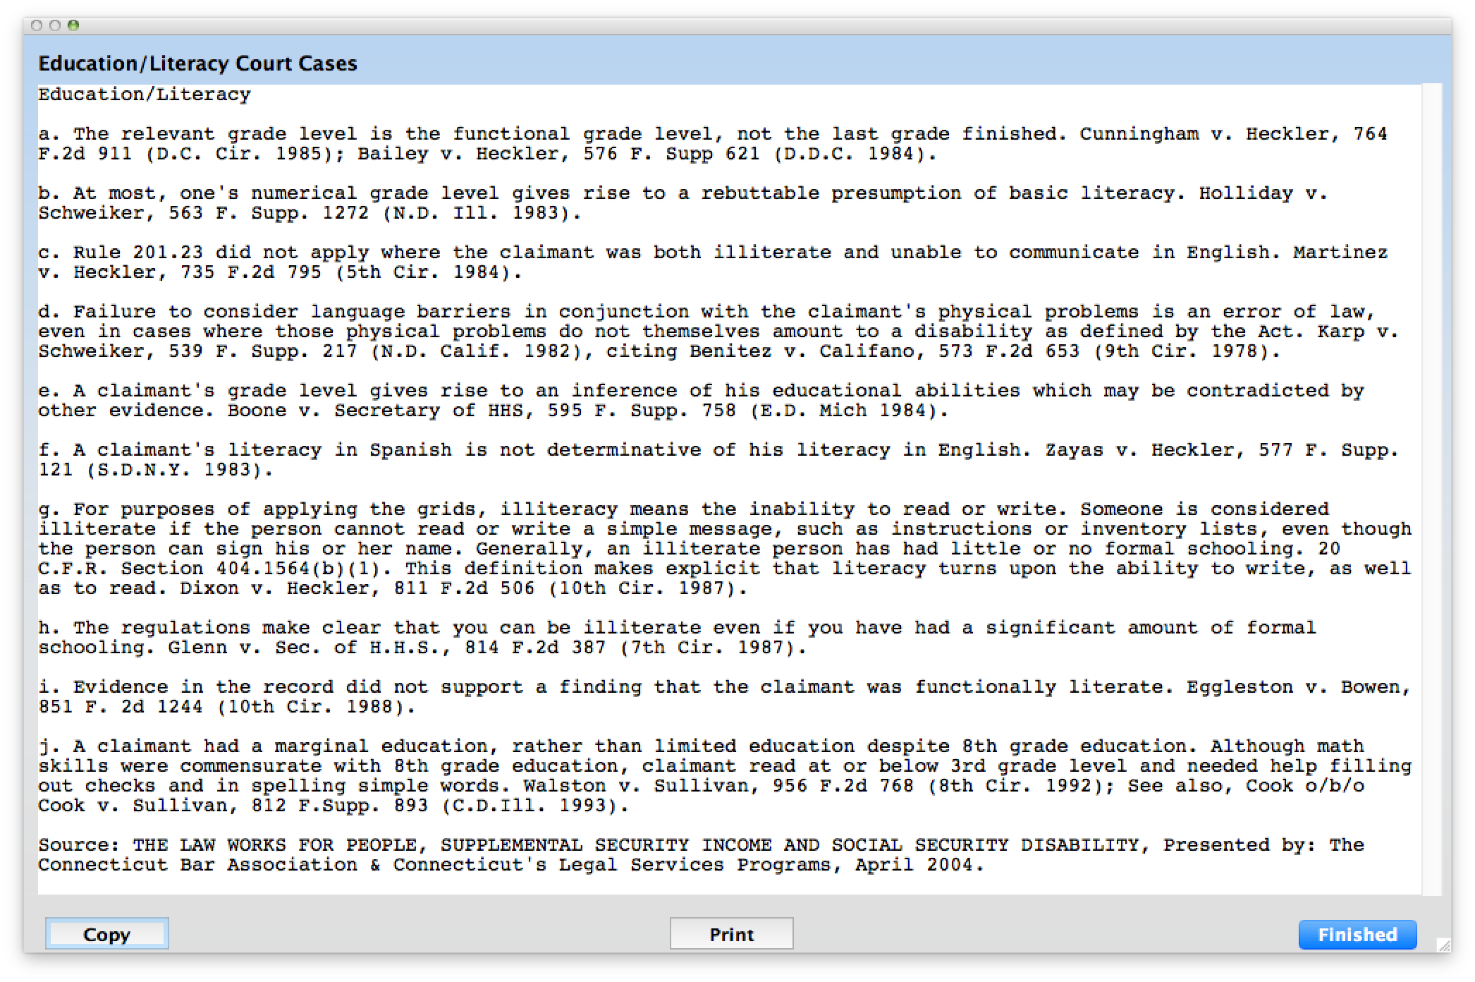
Here are citations of a number of court cases on the subject of Education/Literacy. You can copy and paste appropriate items
into your brief. The first case says that the relevant grade level is the functional grade level, not the last grade finished.

Slide 49
Any Questions?

